Slide 1


FINAL VERDICT OF SUPREME COURT OF
VODAFONE CASE.
Place photo here

Slide 2
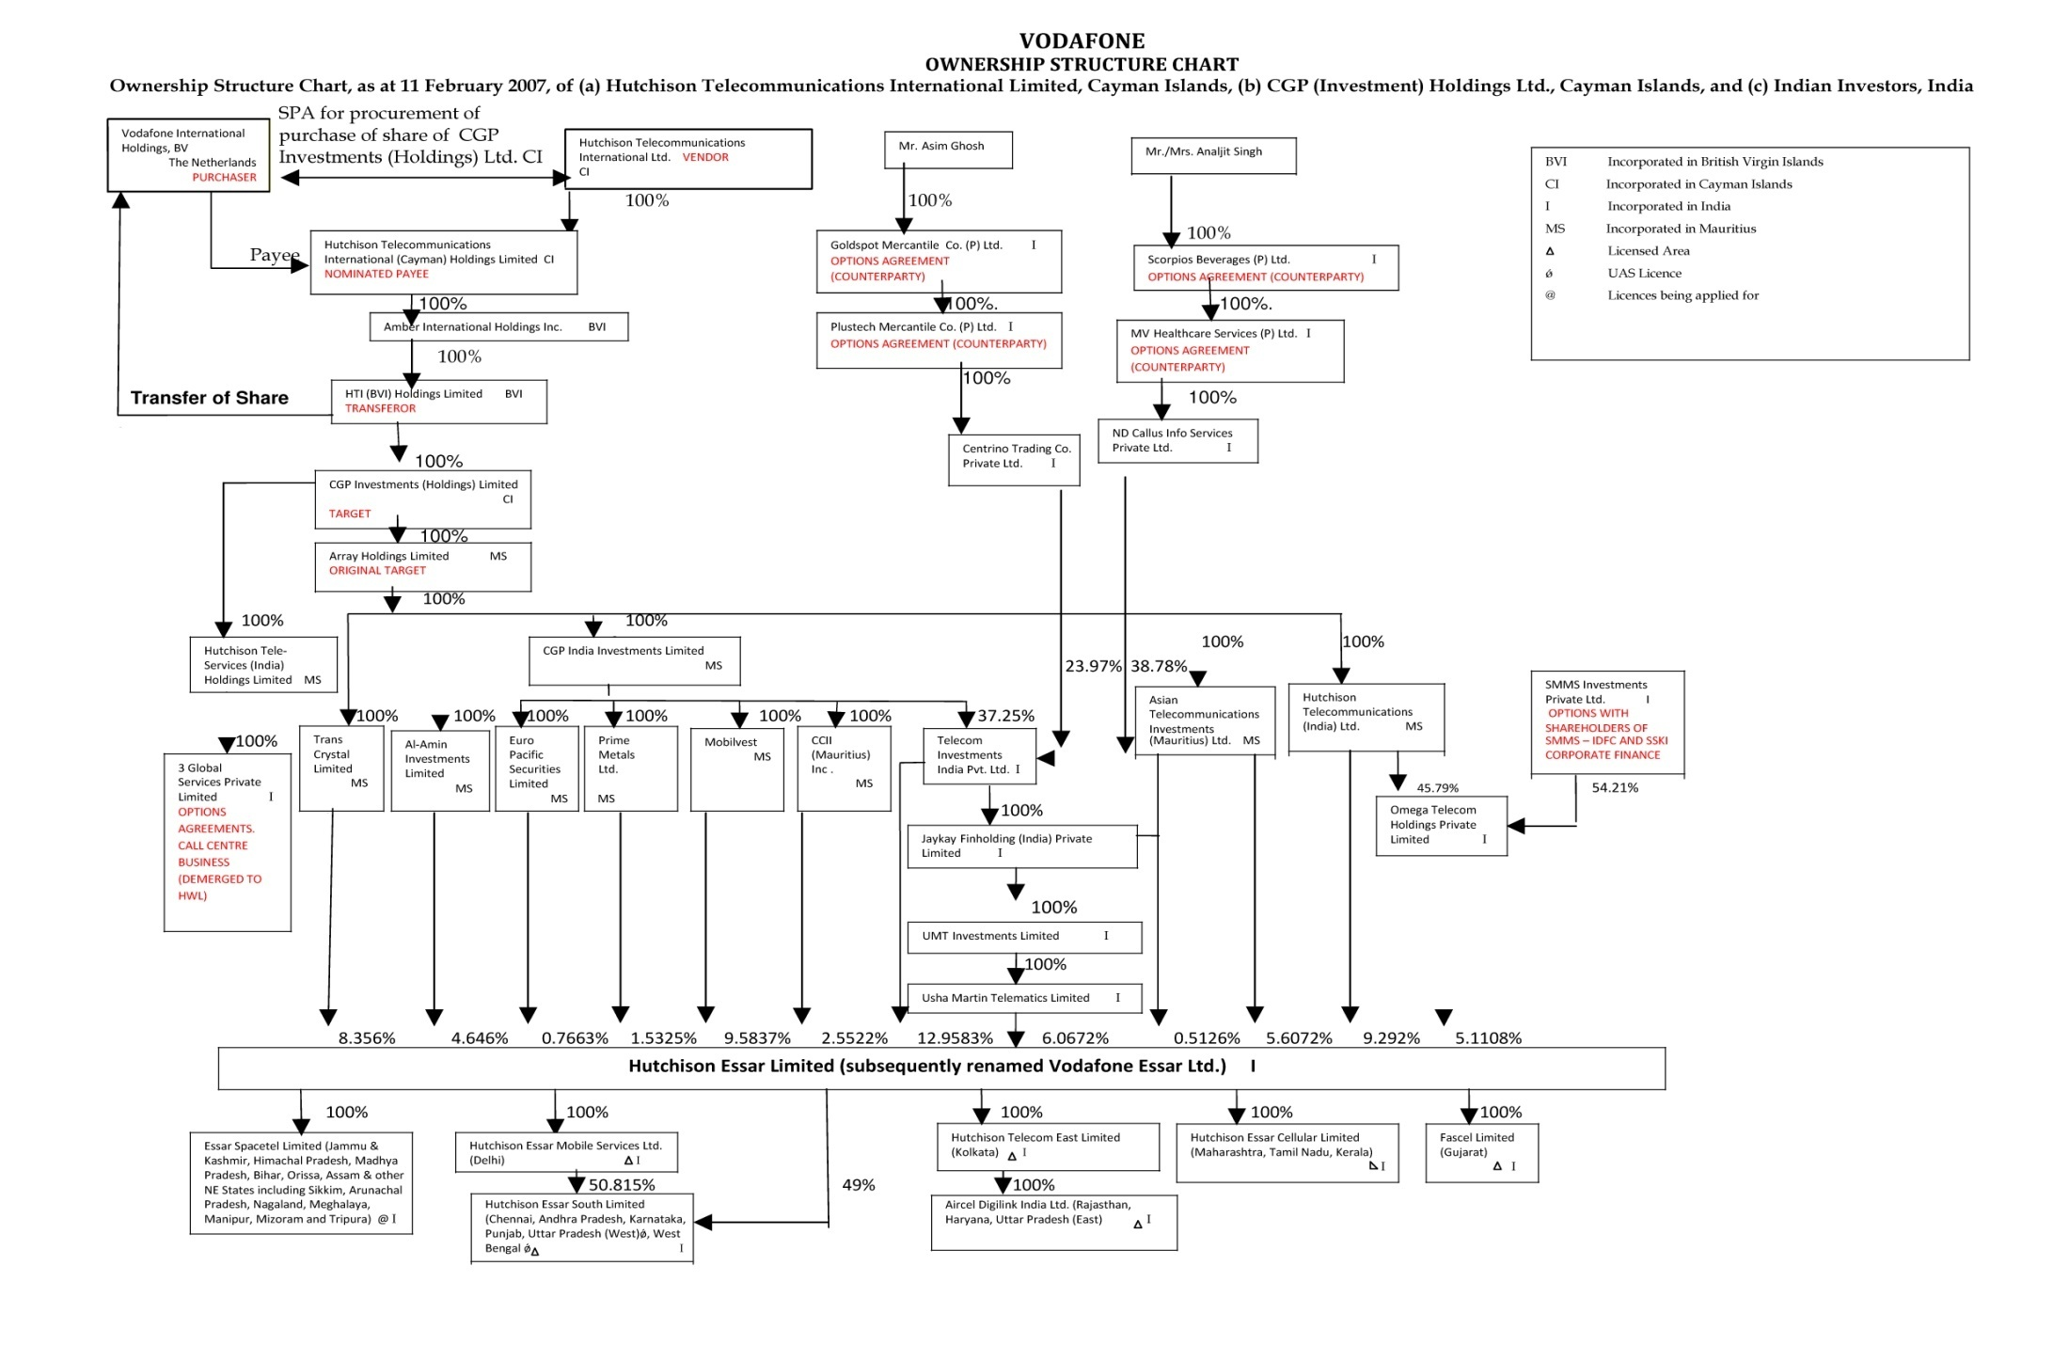
Ownership Structure Chart

Slide 3
1992 | The Hutchison Group of Hong Kong acquired interest in the mobile telecommunications industry in India, through a joint venture vehicle, Hutchison Max Telecom Ltd, (renamed Hutchison Essar Ltd- (HEL) in August, 2005);
Jan 1998 | The Hutchison Group Incorporation CGP Investments (Holdings) Ltd (CGP) in Cayman Islands;
2004 | Hutchison Telecommunication International Ltd (HTIL) was incorporated and listed on the Hong Kong and New York Stock Exchanges. HTIL and its downstream companies (including CGP) held interest in the mobile telecommunications business in several countries including India;
Dec 2006 | HTIL puts its 67% stake in HEL up for sale, seeks bids from interested parties; Vodafone; Hinduja, Reliance Communications among the bidders.
Feb 11,2007 | Vodafone Group Plc makes a final binding offer of US $ 11.076 billion, based on an enterprise value of US $ 18.800 billion of HEL. Hutch board accepts Vodafone Offer.
Mar 6, 2007 | Essar files objection with FIPB to Hutch-Vodafone deal, asserts that it has a ‘Right of First Refusal’.
Mar 15,2007 | HTIL arrives at a settlement with JV partner Essar, pays the latter $415mn. Essar agrees to support the Hutch – Vodafone deal.
Mar 15,2007 | The Joint Director of Income Tax (International Taxation) issues a notice under section 133(6) of the Income Tax Act, 1961 to HEL seeking information regarding the sale of stake of the Hutchison group in HEL, including the Shareholders agreements and details of the transaction for acquisition of the share capital of CGP;
Aug, 2007 | IT Department issues show-cause notice to VEL u/s 163(1) of the Income Tax Act, 1961 to explain why it should not be treated as a representative assesses of Vodafone International Holdings (VIH BV);
Sept, 2007 | IT Departments issues notice u/s. 201(1) and 201(1A) to VIH BV to show cause as to why it should not be treated as an assessee in default for failure to withhold tax;

Slide 4
Oct, 2007 | Vodafone files a writ petition, orders Vodafone to submit relevant documents to IT Dept;
Dec, 2008 | Bombay HC quashes writ petition, orders Vodafone to submit relevant documents to IT Dept’
Dec, 2008 | Vodafone files SLP in Supreme Court against Bombay HC Order;
Jan, 2009 | Supreme Court dismisses SLP, orders that tax department first pass an order on jurisdiction issue, against which Vodafone can approach the Bombay HC;
May, 2010 | IT Dept issues 763 pages final order, claiming jurisdiction to tax the deal. It calculates a liability of around Rs. 12000 Cr;
June, 2010 | Vodafone files a writ petition in Bombay HC challenging the IT Department’s final order of May 2010;
Sep, 2010 | Bombay HC again rules in favour of IT Dept, says the target company at all times was HEL;
Oct, 2010 | IT Dept fixes liability of Rs. 11,297 Crore;
Nov, 2010 | SC directs Vodafone to deposit Rs. 2500 Cr and provide bank guarantee for Rs. 8500 Cr;
March,2011 | IT Dept issues penalty notice u/s.271C to Vodafone for failure to deduct tax at source;
April,2011 | Vodafone files SLP in Supreme Court against penalty notice. SC Orders IT dept to pass penalty order, but not to enforce it;
May, 2011 | IT Department passes Rs. 7900 Cr penalty order on Vodafone
Aug 2,2011 | Supreme Court proceedings begin;
Oct 13,2011 | Supreme Court proceedings conclude, judgment awaited.
Jan 20, 2012 | Finally Supreme Court handed down judgments.

Slide 5
Backgrouund
B.V. Vodafone International Holdings (Vodafone) bought 100% shares of CGP Investments (Holdings) Ltd. (CGP) from Hutchinson group, Hong Kong (HTIL).
CGP held 67% stake in Hutch Essar (India) Ltd. (Hutch)
While making payment to HTIL, Vodafone did not deducted tax at source.
Basic Questions of Chargeability (against Vodafone)
- Lifting of Corporate Veil.
- Transfer of underlying asset in India.
- Relinquishment of rights in India.

Slide 6


Final Decision of Supreme Court of India
Vodafone was not required to withhold tax from the payments made to HTIL.
Offshore transaction of acquisition of shares of CGP by Vodafone International Holdings BV (VIH) from HTIL was bonafied structured foreign direct investment (FDI) investment in India, Which fell outside India’s Revenue’s territorial tax jurisdiction and hence transaction was not taxable
Notes:
Insert a map of your country.

Slide 7
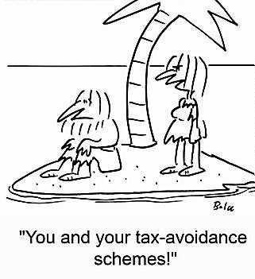
Final Decision of Supreme Court of India
The Important Principles of Law enunciated by the Supreme Court in arriving at the following conclusion are as below :
TAX AVAOIDANCE/ EVASION
AZADI BACHAO ANDOLAN Vs.
McDowell :
Supreme Court in Vodafone’s case dealing with the contention raised on behalf of the Revenue that the decision in case of Azadi Bachao Andolan 263 ITR 706, full bench decision, need to be overruled in so far as it depart from principle laid down in earlier decision
Notes:
Insert a picture of one of the geographic features of your country.

Slide 8

Final Decision of Supreme Court of India
In case of ‘McDovell & Co Ltd. 3 SCC 230 (1985).
As regards treaty shopping and/ or tax avoidance, there is no conflict between Azadi Bachao Andolan and Mc Dowell and no consideration by a larger bench on the some is required.
Further finally supreme court observed that genuine strategic planning had not been abandoned by any decision of the English Courts till date like “Ramsay Ruling” “Craven V White” 1988 3 all E.R. 495 & Westminster principle” and held that the position of Azadi Bachao’s ruling would continuance to prevail in terms of the vodafone’s decision.
Notes:
Insert a picture of one of the geographic features of your country.

Slide 9
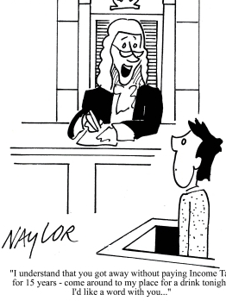
Final Decision of Supreme Court of India
(B) HOLDINGSTRUCTURE – SEPARATE ENTITY PRINCIPLE TO BE RESPECTED :
The Court explained that there is difference between having power and having persuasive position, and held that directors and not share holder’s are the managers of a company and their powers are not obliterated because of shareholder’s influence, except where subsidiaries are created as sham.
The revenue should look at the documents or the transaction in the context to which it properly belongs and as a whole instead of adopting dissecting approach.
Notes:
Insert a picture of one of the geographic features of your country.

Slide 10

Final Decision of Supreme Court of India
Supreme Court concluded that strategic foreign direct investment carrying to India, as an investment destination should be seen in a holistic manner.
The court further observed that there is a conceptual difference between preordained transactions created for tax avoidance and a transaction which evidences investments to participate in India.
The issue of defacto vs legal control, legal rights vs participation rights etc were not material in such a situation.
In short, the onus will be on the Revenue to indentify the scheme and
Notes:
Insert a picture of one of the geographic features of your country.

Slide 11

Final Decision of Supreme Court of India
its dominant purpose. The corporate business purpose of a transaction is evidence of the fact that the transaction is not undertaken as a colorable or artificial device. The stronger the evidence of device, the stronger the corporate business purpose must exist to overcome the evidence of a device.
(C)Interpretation of Section 9(1)(i) – Whether it is a “look through” provisions
*Sec.9(1) of the Act deems certain Incomes to accrue or arise in India.
*Sec.9(1)(i) of the Acts deems inter alia, “All Income accruing or arising, whether directly or indirectly…………..
Notes:
Insert a picture of one of the geographic features of your country.

Slide 12

Final Decision of Supreme Court of India
through transfer of Capital Assets situate in India” to accrue or arise in India and hence taxable in India.
*Contention of the Revenue that Income from Sale of CGP Share would fall with in Sec. 9(1)(i) of the Act and as the said section provides for a “Look through” approach. Which cover indirect transfer of capital assets.
The SC disagreeing with the arguments advanced by the Revenue held as under:
1. A Legal fiction has limited scope & can’t be expanded by giving it purposive interpretation. Particularly when it would transform the concept of chargeability under JTL.
Notes:
Insert a picture of one of the geographic features of your country.

Slide 13
Final Decision of Supreme Court of India
2. The World ‘Indirect’ qualifies income and not term ‘transfer’ of capital asset.
The words underlying asset do not find place in Sec.9(1)(i) & Can’t be read there in.
Proposed DTC Bill of 2009 & 2010 expressly provides for taxation of indirect transfer & not governed by Sec 9(1)(i).
Thus, the question of providing a ‘look through’ or ‘limitation on benefits’ (LOB) provision in the statute or in the treaty is a matter of policy and needs to be expressly provided by way of specific legislation.
Notes:
Insert a picture of one of the geographic features of your country.

Slide 14
Final Decision of Supreme Court of India
Section 195 & Sec. 163 – Whether applicable to None Resident payers :
Justice K.S. Radakrishnan in a separate but concurring decision, when even a step further to hold that section 195 of the Act is applicable to payments made by Resident to Non-Residents and not to payment by Non-Resident to another Non-Resident outside India.
Similarly Section 163 of the Act (pursuant to which the tax authorities alleged that Vodafone is a “Representative Assessee” of HTIL in India) would not have application in the facts of the case there is no transfer of capital asset situated in India.
Notes:
Insert a picture of one of the geographic features of your country.

Slide 15
Final Decision of Supreme Court of India
(D)Whether HTIL’s property rights in HEL were extinguished :
The Supreme Court held that present case, when looked at holistically was concerned with the sales of shares and not with sale of assets.
Applying the ‘look at’ test and without restoring to the dissecting approach extinguishment of rights, if any took place because of the transfer of the CGP Share and not by virtue of various clauses of SPA.
(E)Whether acquisition of CGP share should be divorced from various other rights and entitlements following there from :
Notes:
Insert a picture of one of the geographic features of your country.

Slide 16
Final Decision of Supreme Court of India
-> Court held that considering the subject matter of the transaction from a commercial and realistic perspective there was a share sale and not asset sale. A controlling interest is an incidence of ownership of shares in a company which flows out of holding of shares.
-> Supreme Court ruled that CGP was not only a holding company but also enabled a smooth transaction of the business. Although there was an alternate option available, transferring the shares of CGP enable Vodafone to acquire the business smoothly.
Notes:
Insert a picture of one of the geographic features of your country.

Slide 17
Final Decision of Supreme Court of India
Comments :
First time in Indian Judiciary Supreme Court needs to be complemented for comprehensively analyzing the various issues, examining the investment structure & not suspicion and taking holistic rather than Pedantic view.
“Look at” approach, the SC has only ‘looked at’ a few clauses in the agreements and not “looked at” all relevant clauses in SPA/ SHA.
Thus, Supreme Court has laid down several important and far reaching & care principles of law on
Tax Planning Vs Tax Avoidance.
Interpretation of Sec. 9
Notes:
Insert a picture of one of the geographic features of your country.

Slide 18
Final Decision of Supreme Court of India
Comments :
TDS Obligation U/s. 195 applicability of Sec 163. interpretation of statues.
Policy towards foreign investment FDI.
Notes:
Insert a picture of one of the geographic features of your country.

Slide 19

www.pkmodi.com
Thank You !

