Slide 1


Vodafone Case Study
Analysis of Arguments made Before
Supreme Court
November - 2011
www.pkmodi.com

Slide 2
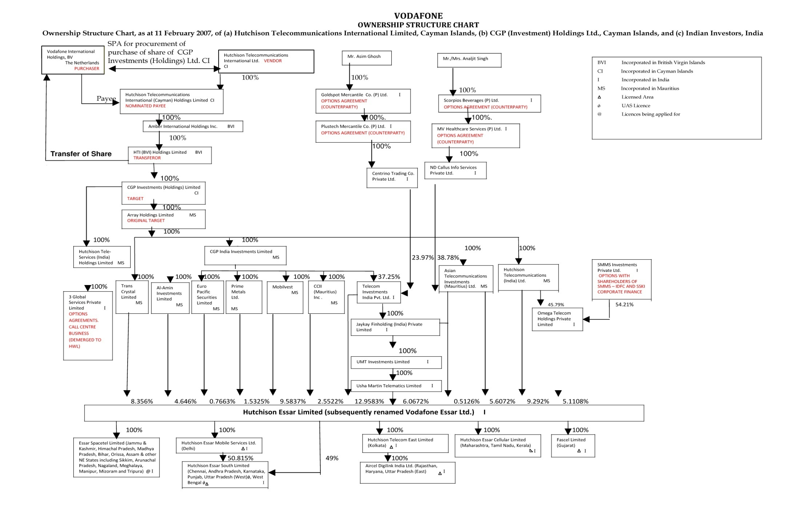

Slide 3
Vodafone Timeline
1992 | The Hutchison Group of Hong Kong acquired interest in the mobile telecommunications industry in india, through a joint venture vehicle, Hutchison Max Telecom Ltd, (renamed Hutchison Essar Ltd- (HEL) in August, 2005);
Jan 1998 | The Hutchison Group Incorporation CGP Investments (Holdings) Ltd (CGP) in Cayman Islands;
2004 | Hutchison Telecommunication International Ltd (HTIL) was incorporated and listed on the Hong Kong and New York Stock Exchanges. HTIL and its downstream companies (including CGP) held interest in the mobile telecommunications business in several countries including India;
Dec 2006 | HTIL puts its 67% stake in HEL up for sale, seeks bids from interested parties; Vodafone; Hinduja, Reliance Communications among the bidders.
Feb 11,2007 | Vodafone Group Plc makes a final binding offer of US $ 11.076 billion, based on an enterprise value of US $ 18.800 billion of HEL. Hutch board accepts Vodafone Offer.
Mar 6, 2007 | Essar files objection with FIPB to Hutch-Vodafone deal, asserts that it has a ‘Right of First Refusal’.
Mar 15,2007 | HTIL arrives at a settlement with JV partner Essar, pays the latter $415mn. Essar agrees to support the Hutch – Vodafone deal.
Mar 15,2007 | The Joint Director of Income Tax (International Taxation) issues a notice under section 133(6) of the Income Tax Act, 1961 to HEL seeking information regarding the sale of stake of the Hutchison group in HEL, including the Shareholders agreements and details of the transaction for acquisition of the share capital of CGP;
Aug, 2007 | IT Department issues show-cause notice to VEL u/s 163(1) of the Income Tax Act, 1961 to explain why it should not be treated as a representative assesses of Vodafone International Holdings (VIH BV);
Sept, 2007 | IT Departments issues notice u/s. 201(1) and 201(1A) to VIH BV to show cause as to why it should not be treated as an assessee in default for failure to withhold tax;

Slide 4
Vodafone Timeline
Oct, 2007 | Vodafone files a writ petition, orders Vodafone to submit relevant documents to IT Dept;
Dec, 2008 | Bombay HC quashes writ petition, orders Vodafone to submit relevant documents to IT Dept’
Dec, 2008 | Vodafone files SLP in Supreme Court against Bombay HC Order;
Jan, 2009 | Supreme Court dismisses SLP, orders that tax department first pass an order on jurisdiction issue, against which Vodafone can approach the Bombay HC;
May, 2010 | IT Dept issues 763 pages final order, claiming jurisdiction to tax the deal. It calculates a liability of around Rs. 12000 Cr;
June, 2010 | Vodafone files a writ petition in Bombay HC challenging the IT Department’s final order of May 2010;
Sep, 2010 | Bombay HC again rules in favour of IT Dept, says the target company at all times was HEL;
Oct, 2010 | IT Dept fixes liability of Rs. 11,297 Crore;
Nov, 2010 | SC directs Vodafone to deposit Rs. 2500 Cr and provide bank guarantee for Rs. 8500 Cr;
March,2011 | IT Dept issues penalty notice u/s.271C to Vodafone for failure to deduct tax at source;
April,2011 | Vodafone files SLP in Supreme Court against penalty notice. SC Orders IT dept to pass penalty order, but not to enforce it;
May, 2011 | IT Department passes Rs. 7900 Cr penalty order on Vodafone
Aug 2,2011 | Supreme Court proceedings begin;
Oct 13,2011 | Supreme Court proceedings conclude, judgment awaited.

Slide 5
Contents
1
Background
2
Issues Involved
3
Arguments before Hon.SC by Vodafone
4
Arguments before Hon.SC by Revenue
4
5

Slide 6
Contents
1
Background
B.V. Vodafone International Holdings (Vodafone) bought 100% shares
of CGP Investments (Holdings) Ltd. (CGP) from Hutchinson group,
Hong kong (HTIL).
CGP held 67% stake in Hutch Essar (India) Ltd. (Hutch)
While making payment to HTIL, Vodafone did not deducted tax at
source.
Basic Questions of Chargeability (against Vodafone)
- Lifting of Corporate Veil.
- Transfer of underlying asset in India.
- Relinquishment of rights in India.
4

Slide 7
Contents
2
Issues Involved
Contentions of Revenue Authorities.
  Such transfer of shares represents transfer of business assets in India and therefore liable to tax in India.
  Vodafone should have deducted tax at source while making payment.
  A show cause notice was served on Vodafone asking as to why it should not be treated as assessee in default for failure to deduct tax on source.
4

Slide 8
Contents
3
Arguments before Hon.SC by Vodafone
(Date wise)
03.08.2011
1st Day of Hearing :
1. India doesn’t have “Look through” provision in Tax Law.
2. S C Ruling in case of Azadi Bachao relied upon.
Chargeability.
- Legal form of transaction cannot be disregarded in absence of fraud/
sham.
- Absent fraud, transfer of control of downstream companies is not a
basis for asserting tax jurisdiction.
- court observed that sale & lease back transaction could not be called
bogus just because there is tax saving.
-”Should we go by sites or can I T department tax it because of control
of Indian business has been transferred ?”
4

Slide 9
Contents
3
Arguments before Hon.SC by Vodafone
(Date wise)
04.08.2011
2nd Day of Hearing :-
- Sec. 9(1)(i) interpretation dominates Day 2 of Vodafone Proceedings
- Source of Income lies where the transaction is effected & not where
the economic interest lies.
- “Substance Vs. Form”
- As long as the transaction is bonafied & not a colorable device, it must
be taxed only in “Form”.
- Clarification on term “Control & Controlling interest”.
4

Slide 10
Contents
3
Arguments before Hon.SC by Vodafone
(Date wise)
09.08.2011
Can’t disrespect “Form” unless
Azadi Bachao revisited, Vodafone to SC
- “Enterprise Value” had been calculated on the basis of underlying
assets of Hutchison in India.
- “How a Share is Valued is irrelevant for determining the situs.
4

Slide 11
Contents
3
Arguments before Hon.SC by Vodafone
(Date wise)
10.08.2011
Substance Vs. Corporate Structuring argued on Day 4 of Vodafone
- Difference between “ Tax havens, and off-shore financial centers
(“OFC).
- “Cayman Island falls in the OFC Category and is not a tax haven”.
- Azadi Bachao applies to only genuine investments or even to conduit
companies”.
- Applying “Ramsay’ Principle- unfair (historic UK case in which
substance was affirmed)
- “ Are we thinking from the point of view FDI, not FII…..
- Rely upon legal opinions from Canada & Us .The Indian
tax department had not been able to show any legal opinion or legal
material to show that situs of Foreign Company’s Share is deemed to
be India”.
4

Slide 12
Contents
3
Arguments before Hon.SC by Vodafone
(Date wise)
11.08.2011
Cayman Island selected as tax neutral jurisdiction. :-
1. “De coupling of assets and income is the fundamental feature of
corporate structure.
2. “UN Model which suggests that capital gains ought to be taxed by
resident country”.
3. Cayman Island was added as a “tax neutral” jurisdiction and not for
tax avoidance.
4. HITL directly sold the shares of the Indian Co. through Mauritius
entity, no tax (263 ITR 706) would have been applicable on the
basis of SC ration on “Azadi Bachao”
4

Slide 13
Contents
3
Arguments before Hon.SC by Vodafone
(Date wise)
17.08.2011
Vodafone transaction Can’t Tax on Economic reality theory : -
‘Look through provisions’ can be applied in the case of ‘horizontal
structures’ only.
‘Holding company structure could not be disregarded unless it
was a sham.
Structure which was already in place for many years, shit of taxing
jurisdiction by itself at the time of exist cannot be the basis to ‘Lift
Corporate veil’
-How value of these shares has been derived would not relevant to
determine tax liability.
4

Slide 14
Contents
3
Arguments before Hon.SC by Vodafone
(Date wise)
18.08.2011
No need to revisit Azadi Bachao Decision :-
- “Tax Evasion & Tax Motive”.
- Whether Azadi Bachao was confirmed to the validity of the CBDT
Circular !!
- ‘Indian Mauritius tax treaty application – Relevant.
- ‘The benefit of India Mauritius treaty would be available only if
Mauritius entity was liable to tax in Mauritius as otherwise, such entity
may not be considered as “Resident of Mauritius”.
- There has not been any change in India Mauritius treaty or CBDT
circular post Azadi decision and hence the decision did not require
any review.
4

Slide 15
Contents
3
Arguments before Hon.SC by Vodafone
(Date wise)
24.08.2011
Hutch – Vodafone Deal a case of sale of shares only :-
- Difference between “lifting of veil’ and finding the real nature of the
transaction”.
-‘Hutch – Vodafone case should be regarded as that of “sale of shares ”
only & nothing else, no motive to avoid taxes by sale of shares of
upstream company above Mauritius.
4

Slide 16
Contents
3
Arguments before Hon.SC by Vodafone
(Date wise)
25.08.2011
Legitimate tax planning permissible : -
- Timing and stage of the transaction were very important and not
“motive” to save taxes.
- Tax is levied on “transaction’ and not its effects.
- Can Holding Co dictate terms to subsidiary question CJ.
4

Slide 17
Contents
3
Arguments before Hon.SC by Vodafone
(Date wise)
30.08.2011
- Drawing a distinction between “Principal Subsidiary’ and “Operating
Subsidiary”.
- Corporate veil test in US is different from that in UK.
4

Slide 18
Contents
3
Arguments before Hon.SC by Vodafone
(Date wise)
01.09.2011
SC poses questions on Essar payment & Ravi Ruia appointment :-
1. Essar was a Separate taxable transaction.
4

Slide 19
Contents
3
Arguments before Hon.SC by Vodafone
(Date wise)
06.09.2011
Indian Law to decide Vodafone case :-
- SC Will deliver its verdict based on Indian Law and Not Foreign Cases
- If the transfer of CGP share is not taxable, then none of the framework
or call & put option agreements between downstream subsidiaries
would make the transaction taxable.
- CGP share was acquired with an objective of acquiring controlling
interest in Indian Company, but still it would not be taxable
4

Slide 20
Contents
3
Arguments before Hon.SC by Vodafone
(Date wise)
07.09.2011 to 13.09.11
Controlling interest cannot be transferred de-hors shares
- No transfer of controlling interest situated in India.
- Concept of ‘Situs of Shares’ is relevant not ‘quantum’ of shares to
determine Indian taxability.
- Only shares could be taxed, not its attributes.
- See 195 can’t be applicable without any presence in India.
4

Slide 21
Contents
3
Arguments before Hon.SC by Vodafone
(Date wise)
14.09.2011
Day 16 in Vodafone Case hearing : -
- SC asked to Vodafone “What is the value of shares without the
underlying assets ?
- Reply by counsel that commercial connotation would not affect the
legal connation of the transaction.
- Nexus can’t be used to tax transaction u/s. 9 of Income Tax Act,1961.
- Looming theory of Nexus could not be used to bring an overseas
share transfer to tax.
- Vodafone conclude his arguments on Sept 15th 2011.
4

Slide 22
Contents
4
Arguments before Hon.SC by Revenue
20.09.2011
Stage set for I.T. Department Counter :-
Solicitor General Nariman began his arguments on behalf of Income Tax Dept .
Cayman Island Company’s (CGP )Share’s sale is an ‘artificial and
tax avoidance scheme, Azadi Bachao bad law 5 JJ Vs 2JJ.
‘ Overrule Azadi Bachao’ since the ratio therein was contrary to larger bench decision in Mcdouce11.
Original idea of the parties was to sell shares in Indian Company (HEL), directly but, CGP was introduced because the Mauritius treaty would not apply.
4

Slide 23
Contents
4
Arguments before Hon.SC by Revenue
“Payee (HTIL) is not the legal owner of shares”
One has to look at real intention, not the stated intention.
There is no conceptual clarity in Hon Bombay High Court Order…… Hon HC is Contradicting itself in many paras.
The definition of capital asset included the term “property” which has a wide ambit and includes ‘Rights in Properties’.
Objective of Sec.9 would be defeated if one gave ‘undue weightage’ to the term ‘Situated in India ‘ do not look at Sec.9(1) in Isolation.
Vodafone could not have stepped into the shoes of HTIL without the share purchase agreements.
10% stake held by Vodafone in Bharti (prior to acquiring Hutch) was a clear presence in India for the purpose of Sec.195 especially since Vodafone had termed Bharti as its “Joint venture Partner”
4

Slide 24
Contents
4
Arguments before Hon.SC by Revenue
21.09.2011
On Day 2nd of IT Department’s arguments :
Various clauses of share purchase agreement (SPA) to show that there was much more than the sale of a solitary CGP share by Hutch to Vodafone.
HTIL was the beneficial owner of CGP shares and was not the seller.
Special emphasis on the clause requiring resignation of HTIL director’s on board of HEL terming the same as “Extinguishment”.
CGP was registered as an ‘Exempt’ company in Cayman Islands which meant that it could only do business abroad and
shareholder’s Register outside the country.
4

Slide 25
Contents
4
Arguments before Hon.SC by Revenue
22.09.2011
3rd Day of IT Department’s Arguments :-
“Sec.9 itself is a look through and it should be given a wide interpretation.
HTIL had suddenly, at the last moment, pulled one company (CGP) from the structure to artificially avoid tax.
However that treaty benefits could not be denied merely because a company had been “interposed” at last minute…<<<Bench ?
3 Critical factors in above case leading to conclusion of structure being an artificial tax avoidance scheme.
1. Background facts being different from words used in SPA.
2. SPA showing that commercial substance was different than nomenclature employed by parties.
3. Subsequent interpreting statement by parties.
4

Slide 26
Contents
4
Arguments before Hon.SC by Revenue
Different Countries had introduced a ‘look through’ provision with different objectives but stressed that “HTIL” having lifted its own veil, there is very little for court to do”.
The words ‘situated in India’ should not be construed literally but
construed purposively.
4

Slide 27
Contents
4
Arguments before Hon.SC by Revenue
27.09.2011
Day 4 of IT Departments arguments was dominated by case laws on ‘Form Vs. Substance’
  Revenue contended that on Swiss court judgment. Which disallowed treaty shopping.
  Dictionary meaning of the words ‘through’ and transfer,
  appearing in sec 9(1).
  As for the word ‘transfer’, it was an inclusive definition and
  the word meant ‘direct or indirect’.
  The original intent of sec 9(1) is whatever income arises out
  of India, so long as source can be traced to India, it will fall
  within the ambit of section.
4

Slide 28
Contents
4
Arguments before Hon.SC by Revenue
28.09.2011
McDowel and Azadi Bachao having the potential of changing the
entire landscape of interpretation of Indian Tax Laws.
Para 44 to 47 of McDowell rolling and stated that the 4 paras need to be read together. Para 45 is only referred in Azadi
Bachao
Nariman (SGP), submitted that 2 judge bench in Azadi could not overruled a 5 Judge bench judgment of McDowell.
“Call and put options would be taxable since they are only a hedging mechanism. ‘call and put options’ are property Rights and not merely ‘contractual rights’.
4

Slide 29
Contents
4
Arguments before Hon.SC by Revenue
29.09.2011
Chief Justice Kapadia added that SC decision in Azadi may need to be evaluated only in respect of observations relating to tax avoidance and not in respect of the validity of the CBDT Cir No.789 in the context of India-Mauritius treaty.
Substance over form by reference to SPA clauses. SPA itself had ignored the corporate structure.
Situs of shares should be determined bases on rational grounds.
Opinion of Foreign Tax Experts produced before the court should be completely ignored as they were not based on specific terms of Hutch- Vodafone SPA, but based on respective Foreign Laws not Indian Laws.
4

Slide 30
Contents
4
Arguments before Hon.SC by Revenue
Vodafone had presence in India on account of its shareholding & JV with Bharti and therefore on the date of payment to Hutch ,Sec 195 was applicable to the UK based telecom giant.
Vodafone filed his rejoinder on 11th Oct 2011 on this issues.
4

Slide 31
Contents
4
Arguments before Hon.SC by Revenue
11.10.2011
Harish Salve Vodafone counsel argued that pursuant to acquiring the CGP share, Vodafone acquired rights in the entire structure and that ‘right to manage’ the Indian company flew from voting rights in shares.
Controlling interest could not be transferred ‘de-horse’ shares.
SPA clause requiring HTIL to procure the sale of CGP share was a standard clause to protect the interest of Vodafone.
There is a distinction between legal right and a contractual right and the definition of transfer u/s. 2(47). Which provides for ‘ extinguishment’ is attracted for transfer of a ‘legal right’.
Countering Income Tax Departments argument about ‘role of CGP’, Salve argued that CGP was incorporated since 1998 and
was part of the structure since 2005.
4

Slide 32
Contents
4
Arguments before Hon.SC by Revenue
12.10.2011
A + B theory in Spotlight.
Referring to it as A+B approach,
B Refer to various rights &
A Denotes shares.
Salve submitted that Income Tax Department wrongly proceeded on the assumption that there was a transfer of rights.
There was no assignment of any rights and in fact.
In A+B theory, B doesn’t exist.
What can be taxed, is the transaction & not the consequences.
Transaction can be the source of income, but in Vodafone’s case the transaction was carried outside India and hence not taxable
in India.
4

Slide 33
Contents
4
Arguments before Hon.SC by Revenue
13.10.2011
The bench has asked AT&T counsel to argue only on Sec 9 and India Mauritius treaty, without referring to the facts of Vodafone Case.
Court may consider decisions of Azadi, McDowell and also Nathuram Aggarwal ( 5 Judge bench) decision and give a rolling
reconciling the legal principles without referring the same to larger batch.
On Counter arguments of solicitor general on scope of sec 9, Salve submit ed that only the last limb of sec 9(1)- Capital asset
situated in India can tax capital receipt.
4

Slide 34
Contents
4
Arguments before Hon.SC by Revenue
Addressing the arguments raised by SG on Sec 195, Salve Submitted that “Presence” for the purpose of Sec 195 must be based on ‘Residence’ or qua ‘transaction’.
Concluding the marathon 26 days hearing spread over 2 months the bench asked Vodafone and Government Counsels to provide written submissions on a few issues over the Next fortnight.
4

Slide 35
Thank You !
www.pkmodi.com
P.K. MODI & CO.
CHARTERED ACCOUNTANTS
A-411, SAFAL PEGASUS, 100FT ROAD, PRAHALAD NAGAR
SATELLITE, AHMEDABAD-380051
Phone : +91 079 40065204
Email : support@pkmodi.com

