Slide 1
WORKSHOP ON TRANSFER PRICING
METHOD OF COMPUTATION
TNMM - PSM
WIRC, Mumbai
25.10.2013

Slide 2
TNMM - PSM
Transfer Pricing Regime
Overall Demand raised by I.T. Department as on 30.09.2012 : Rs. 1,00,000 Crores (Appx $16 Billion)
Transfer Pricing Adjustment 2012-2013 is Appx Rs.70,000* Crores ($ 11.30 Billion)
Selection of method and to arrive at Arm’s Length price in Transfer Pricing is an Art
*Source : Ministry of Finance “Tax Evasion by Foreign Companies, Press
Information Bureau, GOI, (Aug 30, 2013), ($ = Rs.62 Conversion Rate)
25th October 2013

Slide 3
TNMM - PSM
Transfer Pricing Regime
Outcome of Tax Dispute : 2011-2012
% F – Favorable, % UF - Unfavorable
Source : 16.4.2013. Standing Committee Report on Finance on Demand for Grants
(2013-14), MOF
25th October 2013

Slide 4
TNMM - PSM
Tested Party
Indian Enterprise Vs Foreign Enterprise Case Laws :
Development Consultant : (2008) 115 TTJ 577
Clear Plus India Pvt. Ltd., I.T.A. No.3944/D/2010
FAR Analysis :
Characterization of Taxpayer ( Assessee) and Associate Enterprise thru FAR analysis and International Transaction.
25th October 2013

Slide 5
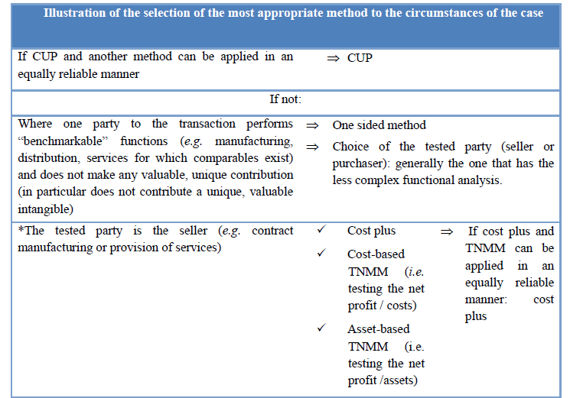
TNMM - PSM
Most Appropriate Method (MAA)
Source OECD – T.P. Methods, July 2010.
25th October 2013

Slide 6
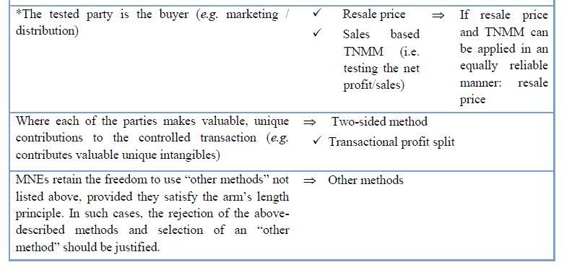
TNMM - PSM
Difference between a resale price & a TNMM for a distributor
(illustration)
Source OECD – T.P. Methods, July 2010.
25th October 2013

Slide 7
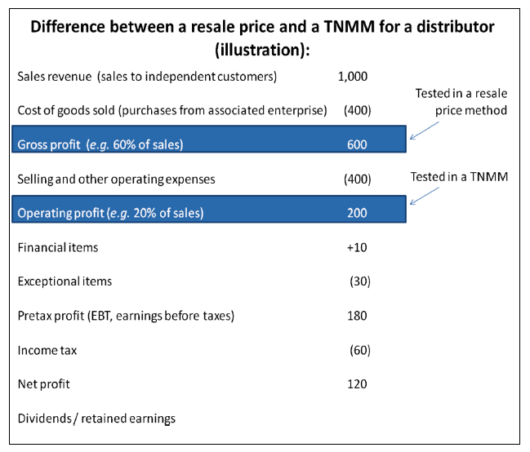
TNMM - PSM
Source OECD – T.P. Methods, July 2010.
25th October 2013

Slide 8
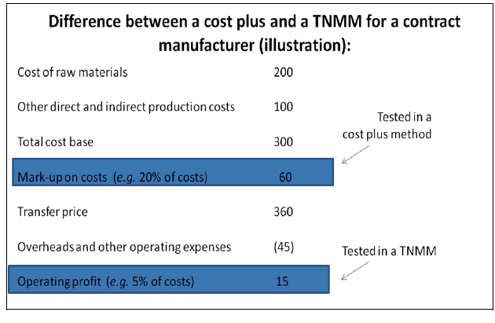
TNMM - PSM
Source OECD – T.P. Methods, July 2010.
25th October 2013

Slide 9
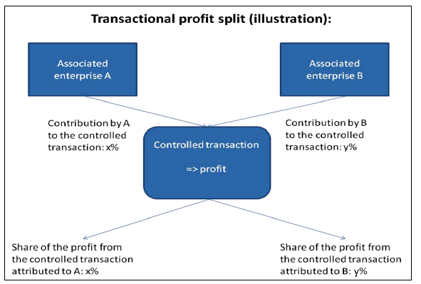
TNMM - PSM
Source OECD – T.P. Methods, July 2010.
25th October 2013

Slide 10
TNMM - PSM
Case Study
Serdia Pharmaceuticals (India) Private Limited
ITA Nos: 2469/Mum/06, 3032/Mum/07 and 2531/Mum/08
>Serdia Pharmaceuticals India Private Limited (Serdia, in short), is a company incorporated in India and 74% of its share capital is held by Servier International BV (Servier BV, in short), a company incorporated in the Netherlands, and the remaining 26% of its share capital is held by a Mauritius based company by the name of Serdia (Mauritius) Limited. Servier BV, in turn, is a subsidiary of Les Laboratoires Servier France (Servier France, in short), a well-known pharmaceutical company which is said to have its presence in more than 140 countries worldwide, including in Egypt by way of a subsidiary in the name of Servier Egypt Industries Ltd Egypt (Servier Egypt, in short).
>Serdia is enagegd in the business of producing drugs mainly in the field of anti-hypertension and metabolism. It produces and markets drugs in finished dosage forms (FDFs) , the COMPANY imports active pharmaceutical ingredient (API) from Servier France and Servier Egypt.
>Serdia has determined the ALP by adopting TNMM AND The claim of the assessee was that
since its operating profit at 8.76% on net sales was higher than 6.67%.
25th October 2013

Slide 11
TNMM - PSM
Case Study
>AEs do not sell these APIs to any independent enterprises in India and that the assessee is not aware of the prices at which these APIs are sold by the related AEs to independent enterprises abroad.
>The TPO noted that while Indapamide was imported by assessee’s competitor from Italy at the price of Rs 40,375 per kg , the assessee had imported by the same, from its AE, at the price of Rs 1,89,456 per kg.
>It was contended that purity levels of Trimetazidine manufactured in India are much lower than purity level of Trimetazidine imported by the assessee, the shelf life of assessee’s API is much longer, the effect of assessee’s API last longer than the effect.
>The TPO was of the view that given the fact that the APIs purchased by the assessee from its AEs abroad are not a unique items AND Comparable Uncontrolled Price (CUP) method is the most appropriate method BY rejecting TNMM.
>The Assessing Officer also noted that, as evident from the correspondence exchanged by the
assessee with Deputy Commissioner of Customs, GATT Valuation Cell, Mumbai, the assessee has himself accepted that ‘increased market competition in India has resulted in overall reduction in prices
> Patented drug vs Generic drug
25th October 2013

Slide 12
TNMM - PSM
Case Study
Unless the Assessing Officer can demonstrate that arm’s length price so computed is not computed in the manner as prescribed in the regulations, he cannot reject the method chosen by the taxpayer.??
>Taxpayer’s documentation should be accepted, unless the Assessing Officer is able to controvert the same.
Does the law require TPO to first comprehensively prove why the methodology adopted by the taxpayer cannot be regarded as the most appropriate methodology, and it is only after proving so that the TPO has the right to use another transfer pricing methodology?
>If differences between the comparables are so material that adjustments cannot be made, then comparables are required to be rejected.
>When payments are approved by one wing of the Government, there is no question of such payment being treated as excessive or unreasonable having regard to legitimate business needs
>Judicial precedents have no binding force of law in India and foreign courts, no matter whatever be the degree of respect that these decisions are extended by the judicial forums in other countries, have no binding precedent value.
>Debt funding component, inventory valuation method and revenue recognition principles etc., which are wholly irrelevant for determination for the ALP of a product, which govern TNMM comparison. A method which can be influenced by such extraneous and irrelevant factors cannot be preferred over a direct method like CUP method.
25th October 2013

Slide 13
TNMM - PSM
Case Study
>The decision of Special Bench in Aztec’s case (supra), they must yield to the larger bench order which has, as we have noted above, held that the Transfer Pricing Officer can determine arm’s length price on the basis of a method other than one adopted by the taxpayer as long as such a change, in the most appropriate method of computing the arm’s length price, is dealt with by way of a speaking order.
>In our considered view, the traditional transaction method have an inherent edge over the traditional profit methods in most of the situations, and, therefore, wherever both the methods can be applied in an equally reliable manner, traditional transaction methods are to be preferred over traditional profit methods. However essentially, a lot depends on the quality of CUP inputs as well.
>Even if all the methods are considered inappropriate for one reason or the other, the method which is less inappropriate is to be applied.
>The grounds on which the Glaxo decisions of the Tax Court of Canada was overturned by the Federal Court of Appeal have nothing to do with claimed superiority of the product, as is the case before us, but on the basis of compulsions of the licence agreement, because of which the assessee was said under an obligation to purchase the API at a higher price.
25th October 2013

Slide 14
TNMM - PSM
Case Study
Tara Ultimo Private Limited
ITA No. 5098/Mum/2010 Assessment year: 2004-05
>The assessee before us is engaged in the business of manufacturer and exporter
of studded diamond and gold jewellery.
>Assessee exported goods worth Rs 29,92,83,448 to its associated enterprises abroad,
out of a total turnover of Rs 107,57,89,057.
>He has adopted cost plus method (CPM) of ascertaining the ALP.
>On the facts and in the circumstances of the case and in law, the ACIT erred in rejecting the CUP
Method in regard to purchase and sale of diamonds with the Associated Enterprises used in the manufacturing and export of jewellery by the appellant.
>The ALP adjustments were thus not only in respect of sales of finished goods to the AEs, but also in respect of imports of diamonds from the AEs and export of diamonds to the AEs.
>In the case of Aztech Software & technology Services Ltd Vs ACIT (107 ITD SB 141), has held that it is not necessary to demonstrate tax avoidance motives before transfer pricing provisions can be enforced.
25th October 2013

Slide 15
TNMM - PSM
Case Study
>The application of CPM has to be on transaction basis rather than on global basis, and this fundamental scheme of cost plus method is also evident from the plain wordings of Rule 10 B as well.
25th October 2013

Slide 16
TNMM - PSM
Case Study
GAP International Sourcing (India) Pvt. Ltd
ITA Nos. 5147/Del2011 & 228/Del/2012 A.Yrs. 2006-07&2007-08
> Assessee (referred to as ‘GIS’ India) is a wholly owned subsidiary of GAP International Sourcing Inc., USA.
> The business activity is claimed to facilitate sourcing of apparel merchandise from India for the GAP Group. Prior to this year similar services were provided by a liaisoning office, after incorporation as wholly owned subsidiary similar services are rendered by this assessee. It shall be pertinent to mention that LO was remunerated at cost+15% for these services.
>Assessee filed its TP report claiming Transactional Net Margin Method (TNMM) with cost plus 15% remuneration to be most appropriate method for determination of Arms Length Price “ALP”. TPO, however looking at the FAR and other factors which are mentioned herein below, rejected assessee’s cost plus 15% ALP and held that commission @ 5% on the FOB value of goods sourced by the foreign enterprise through Indian Vendors was the most appropriate PLI for determining ALP.
>The GAP operates as a limited risk bearing sourcing support service provider.
25th October 2013

Slide 17
TNMM - PSM
Case Study
>The Ld. TPO also alleged that on account of operating in a low cost economy, the assessee had generated location savings in India which have not been factored into in its remuneration model.
>TPO reconstructed the Profit & Loss account of the Appellant by notionally bringing the value of goods sourced by overseas AEs from India, which were neither fully sourced through it nor routed through its financial accounts and its Profit & Loss account.
>As per the “Intangible property” clause of the service and support agreement, GAP Group provides the following information to the assessee :
Vendor list containing business information
-Business information relating to existing or potential new manufacturing vendors
-Software or other business processes
-All know-how, processes and trade secrets
>TPO merely made a bald assumption that the Appellant had created valuable supply chain and human asset intangibles without giving proper reasonings evidential data / proof whatsoever to suggest that any intangibles have been created.
25th October 2013

Slide 18
TNMM - PSM
Case Study
>GIS India’s role is to operate strictly within the confines of the standards prescribed by the overseas GAP Group Companies, where all the key decisions with regard to product design and quality, vendor acceptability/ rejection, vendor pricing, etc. are taken solely by the group companies and the risks arising there from are also borne entirely by the group companies.
>TPO while working out adjustments, drew a totally irrelevant reference from the case of an out of court settlement between USA tax authorities & “Tommy Hilfiger”. Tommy Hilfiger remunerated its buying agency affiliate on the basis of a commission (10% and subsequently 7.5%)
>DRP relied upon Li & Fung India case, where in company provided sourcing support services to its related party based in Hong Kong (Li & Fung HK) under an arrangement of cost plus 5% mark-up. The Li & Fung India (along with its overseas AE - Li & Fung HK) is itself a sourcing company and is engaged in the business of providing sourcing services to third party buyers/
retailers. The Li & Fung India performed all the critical functions, assumed significant risks and used both tangibles and unique intangibles developed by it over a period of time (Intangibles included supply chain management which is important to achieve the strategic and pricing advantage, as well as human intangibles in the form of technical capacity and owned manpower to perform the critical functions).
25th October 2013

Slide 19
TNMM - PSM
Case Study
S.No. Name OP/TC(%)
1. Pantaloon Retail (India) Ltd. 6.70
2. Trent Ltd. 6.19
3. Jaypee Spintex Ltd. 2.77
Arithmetic Mean 5.22
>The advantage of location savings is passed onto the end-customer in the form of lower sale prices. Thus, there is no question of any allocation attributable for location savings to GIS India, which has no role in sale prices.
25th October 2013

Slide 20
TNMM - PSM
Case Study
THYSSENKRUPP IND INDIA
ITA NO:6460/MUM/2012/ A Y . 2008-09
>Assessee is engaged in the business of providing turnkey services for design, manufacture, supply, erection and commissioning of sugar plants, cement plants, bulk material handling equipment and steam and power generation plants.
>International transactions relating to purchase of raw material and components and sale of finished goods.
>During the year in question the assessee imported spares and equipments from its AEs amounting to `23.48 crore and also exported certain equipments and components etc. to its Aes amounting to `82.23 crore. The assessee benchmarked these international transactions by using Transactional Net Margin Method (TNMM) as the most appropriate method by considering Profit Level Indicator (PLI) as Net Operating Margin to Sales (OP/Sales).
>In opinion of TPO , the correct PLI should be Operating profit to Total cost (OP/TC).
>The objections of the assessee in this regard are two-fold. First, that the internal TNMM ought to have been applied, and second, in the alternative, the AO/TPO were not justified in including certain fresh cases and excluding one case.
>If an overlapping takes place, then the entire working is vitiated,
25th October 2013

Slide 21
TNMM - PSM
Case Study
>In the case of ACTIS Advisers Pvt. Ltd. v. DCIT [2012-TII-136-ITAT-DEL-TP], the
Delhi Bench of the Tribunal has held that a case can be taken as uncontrolled if its related parties transactions do not exceed 25% of the total revenue.
>Next objection of the assessee is against considering the entity level results.
>Gillanders Arbuthnot & Company Ltd., which contains information about its various business segments, such as, Trading, Tea, Property, Plastic Container, Textile and “Engineering Division”.
>Government undertakings should not be considered for bench marking study.
>In our considered opinion, when the rate of royalty payment and fee for drawings etc. has been approved or deemed to have been approved by the RBI, then such payment has to be considered at ALP.
25th October 2013

Slide 22
TNMM - PSM
Case Study
Sandoz Private Limited
ITA No. 6922/Mum/2012
>Sandoz is a subsidiary of Novartis Holdings AG, Switzerland and is engaged in pharmaceutical business in India and its operations primarily include manufacture and sale of APIs, manufacture and sale of Finished Drug Formulations and trading of APIs/FDFs and
providing support service to its AEs.
>The TPO did not agree with assessee’s contention of segment-wise TNMM analysis for each of the international transactions on the reason that the segment-wise accounts
are not audited. The TPO adopted an entity method approach for the
purpose of determining ALP.
>Assessee did submit segmental accounts for each of its operation which are different from the other and therefore the correct approach under TNMM should be with each of the segmentals with the corresponding comparables involved in similar lines of functioning after
proper FAR analysis.
>There is no discussion, whatsoever, in TPO’s order as to why the comparables of the assessee are rejected or why other comparables are accepted.
25th October 2013

Slide 23
Thank you
A-411, Safal Pegasus, 100ft Anand Nagar Road
Prahalad Nagar, Satellite, Ahmedabad-380015
www.pkmodi.com, pkm@pkmadvisory.com
(M) - +91 98240 14310
25th October 2013

