Slide 1
Renewable Energy
and
Carbon Credit
Presented By : Pradip K Modi
pkm@pkmadvisory.com

Slide 2
Disclaimer
This presentation is intended for an educational purpose only.
The data / facts / figures used in this presentation have been culled / obtained from various Governmental and non-Governmental agencies published reports and author has no control as to the correctness / veracity of the same.
P.K. Modi & Co. 15.07.2012

Slide 3
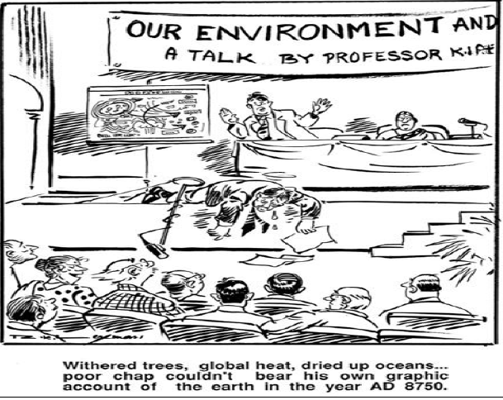
Today’s Discussion : What it is (hopefully) Not About!
P.K. Modi & Co. 15.07.2012

Slide 4
Why Electrical Power and at what speed ?
National growth by Industrialisation
Oxygen of Industrialisation is Power
Elasticity ratio of GDP to Power is 1.25
Power demand by 2020 would be appoximately 250,000 MW
Can Renewable energy be alternative?
India’s initiatives for Renewable energy
P.K. Modi & Co. 15.07.2012

Slide 5
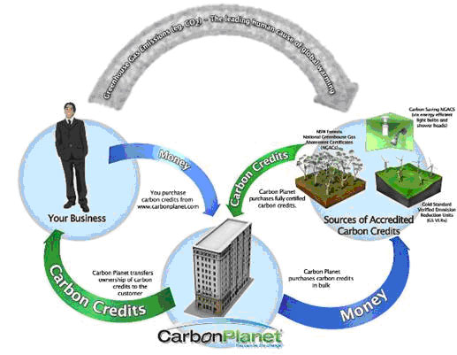
Total Installed Capacity: Power for All by 2012
Sector MW %
State Sector 86,358.65 42.54
Central Sector 60,682.63 29.89
Private Sector 55,937.75 27.55
Total 2,02,979.03
P.K. Modi & Co. 15.07.2012

Slide 6
Energy input mix 0f Resources in Indian Power Generation
(Source: www.powermin.nic.in)
MWs 145797.97 as on 31-6-2008
Fuel MW % age
Total Thermal 134635.18 66.31
Coal 114,782.38 56.54
Gas 18,653.05 9.18
Oil 1,199.75 0.59
Hydro (Renewable) 39,060.40 19.24
Nuclear 4,780.00 2.35
RES** (MNRE) 24,503.45 12.07
Total 2,02,979.03 100.00
P.K. Modi & Co. 15.07.2012

Slide 7

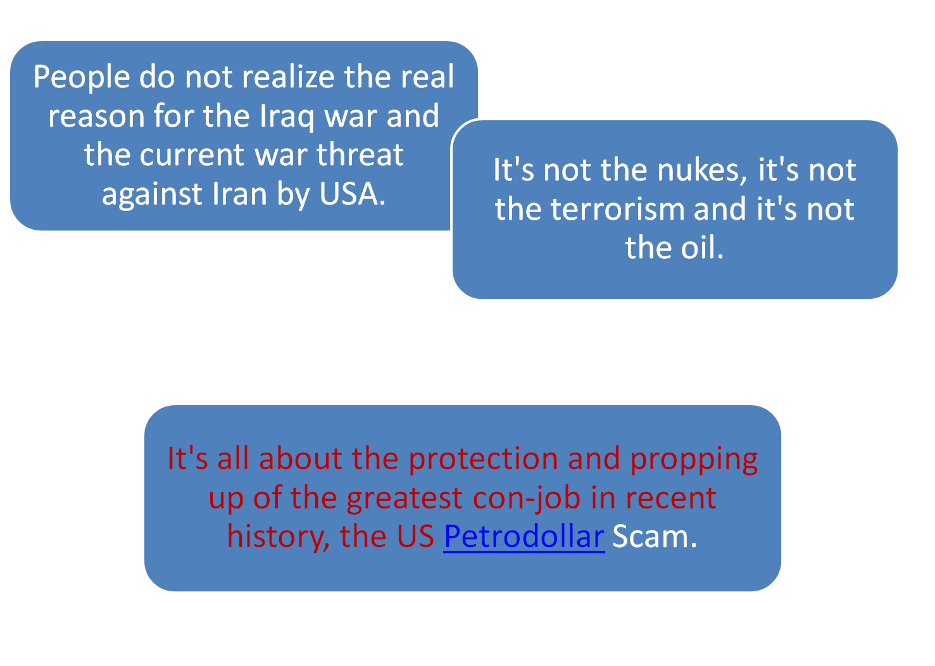
P.K. Modi & Co. 15.07.2012

Slide 8
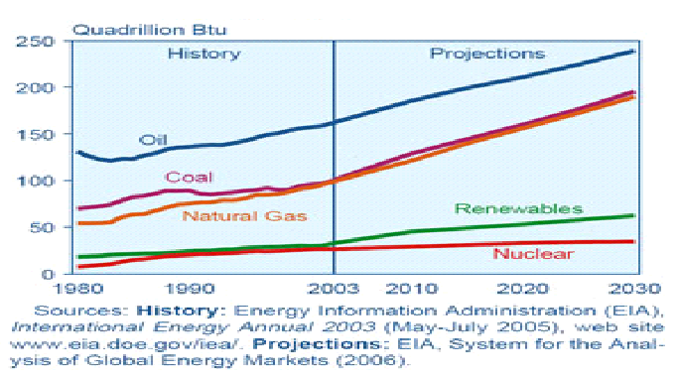
World Marketed Energy Use by Fuel Type : 1980 to 2030
P.K. Modi & Co. 15.07.2012

Slide 9
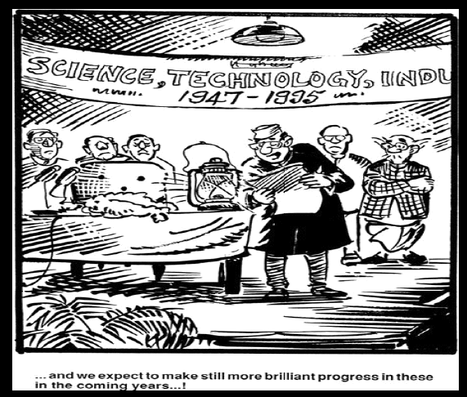
And if things go really well, we may hopefully never see this again (??!!)
P.K. Modi & Co. 15.07.2012

Slide 10
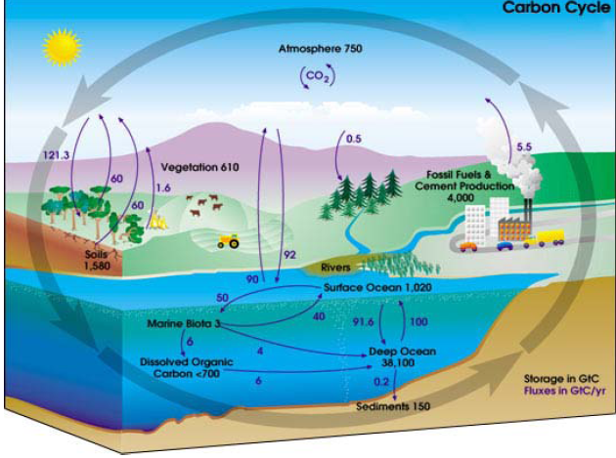
CARBON CYCLE
P.K. Modi & Co. 15.07.2012

Slide 11
P.K. Modi & Co. 15.07.2012

Slide 12
Global Warming Potential referenced to the updated decay response for the Bern carbon cycle model and future CO2 atmospheric concentrations held constant at current levels.
Source: Climate Change 1995, The Science of Climate Change: Summary for Policymakers and Technical Summary of the Working Group I Report, page 22.
Species | Chemical formula | Lifetime (years) | Global Warming Potential (Time Horizon)
 |  |  | 20 years | 100 years | 500 years
CO2 | CO2 | variable § | 1 | 1 | 1
Methane * | CH4 | 12±3 | 56 | 21 | 6.5
Nitrous oxide | N2O | 120 | 280 | 310 | 170
HFC-23 | CHF3 | 264 | 9100 | 11700 | 9800
HFC-32 | CH2F2 | 5.6 | 2100 | 650 | 200
HFC-41 | CH3F | 3.7 | 490 | 150 | 45
HFC-43-10mee | C5H2F10 | 17.1 | 3000 | 1300 | 400
HFC-125 | C2HF5 | 32.6 | 4600 | 2800 | 920
HFC-134 | C2H2F4 | 10.6 | 2900 | 1000 | 310
HFC-134a | CH2FCF3 | 14.6 | 3400 | 1300 | 420
HFC-152a | C2H4F2 | 1.5 | 460 | 140 | 42
HFC-143 | C2H3F3 | 3.8 | 1000 | 300 | 94
HFC-143a | C2H3F3 | 48.3 | 5000 | 3800 | 1400
HFC-227ea | C3HF7 | 36.5 | 4300 | 2900 | 950
HFC-236fa | C3H2F6 | 209 | 5100 | 6300 | 4700
HFC-245ca | C3H3F5 | 6.6 | 1800 | 560 | 170
Sulphur hexafluoride | SF6 | 3200 | 16300 | 23900 | 34900
Perfluoromethane | CF4 | 50000 | 4400 | 6500 | 10000
Perfluoroethane | C2F6 | 10000 | 6200 | 9200 | 14000
Perfluoropropane | C3F8 | 2600 | 4800 | 7000 | 10100
Perfluorobutane | C4F10 | 2600 | 4800 | 7000 | 10100
Perfluorocyclobutane | c-C4F8 | 3200 | 6000 | 8700 | 12700
Perfluoropentane | C5F12 | 4100 | 5100 | 7500 | 11000
Perfluorohexane | C6F14 | 3200 | 5000 | 7400 | 10700
§ Derived from the Bern carbon cycle model. * The GWP for methane includes indirect effects of tropospheric ozone production and stratospheric water vapour production.

Slide 13
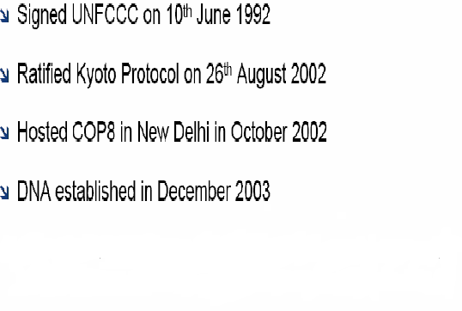
India’s Journey towards Global GHG Mitigation
P.K. Modi & Co. 15.07.2012

Slide 14
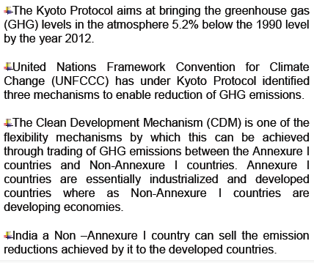
Brief Status of RE in India – Contd.
P.K. Modi & Co. 15.07.2012

Slide 15
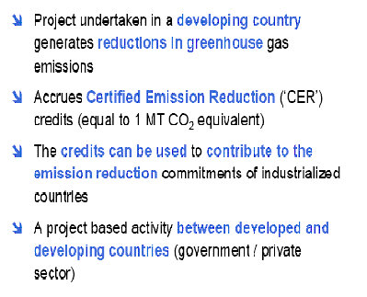
What is CDM ?
Developed Country /
Govt. / Pvt. Sector
Sale Proceeds
Carbon Credits
Reduction at Lower Cost by investing in developing countries where marginal cost of abatement of GHGs is lower
P.K. Modi & Co. 15.07.2012

Slide 16
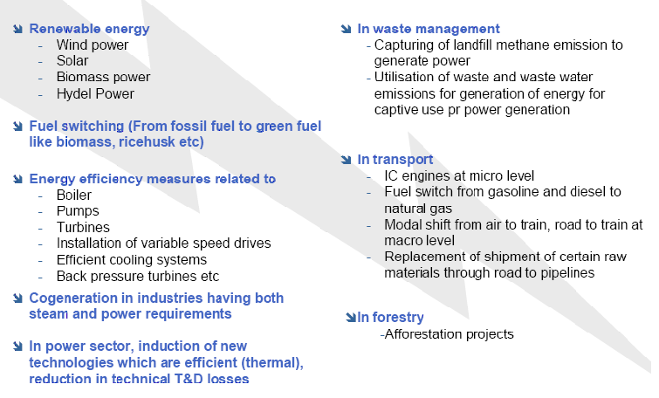
Where is CDM Applicable ?
P.K. Modi & Co. 15.07.2012

Slide 17

Sources of Renewable Energy
Wind
Mini Hydro < 25 MW
Solar-Photovoltaic / thermal
Biomass
Tidal water
Waste
Geothermal
Bio fuel
P.K. Modi & Co. 15.07.2012

Slide 18
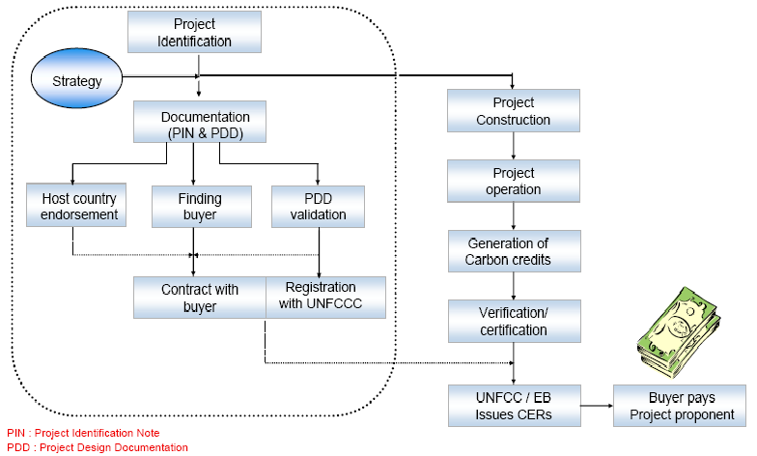
Project Developer
P.K. Modi & Co. 15.07.2012

Slide 19
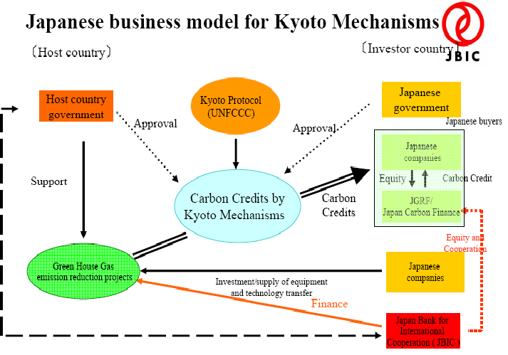
P.K. Modi & Co. 15.07.2012

Slide 20
CDM Statistics
(source: http://cdm.unfccc.int/Statistics/index.html) as on 15-10-2008
 | Annual Average CERs* | Expected CERs until end of 2012**
CDM project pipeline: > 3000 of which | NA | > 2,700,000,000
--- 1183 are registered | 227,697,552 | > 1,330,000,000
--- 91 are requesting registration | 31,237,639 | > 130,000,000
P.K. Modi & Co. 15.07.2012

Slide 21
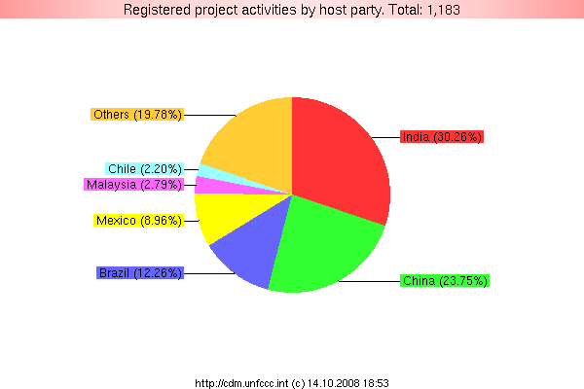
Registration: Indian Registered projects 358
P.K. Modi & Co. 15.07.2012

Slide 22
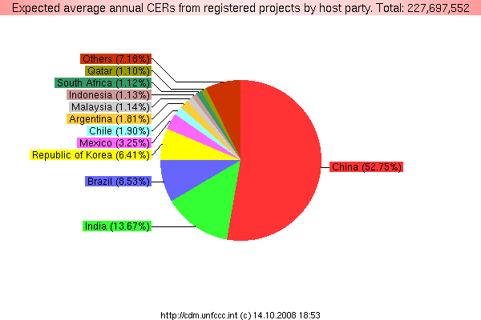
Registration: Carbon Emission Reductions India 31,122,524
P.K. Modi & Co. 15.07.2012

Slide 23
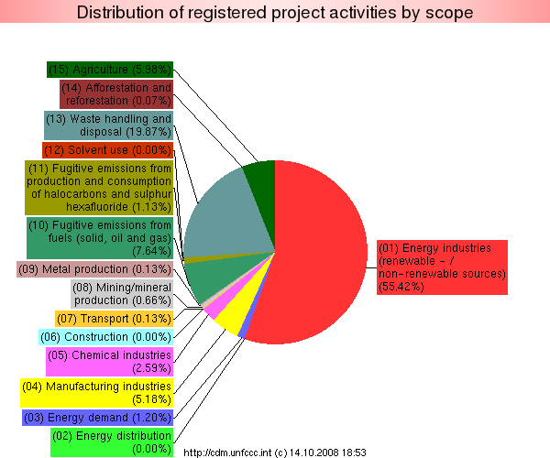
Registration by scope
P.K. Modi & Co. 15.07.2012

Slide 24
What motivates buyers?
Mandatory legal obligation to reduce greenhouse gas emissions
Offset real or contingent risks that regulatory barriers may arise due to significant greenhouse emissions of a project
Voluntary compliance targets for public relations purposes or to promote products as “climate-neutral”
Market for Carbon Credits
Projected €60 billion
by end 2012
P.K. Modi & Co. 15.07.2012

Slide 25
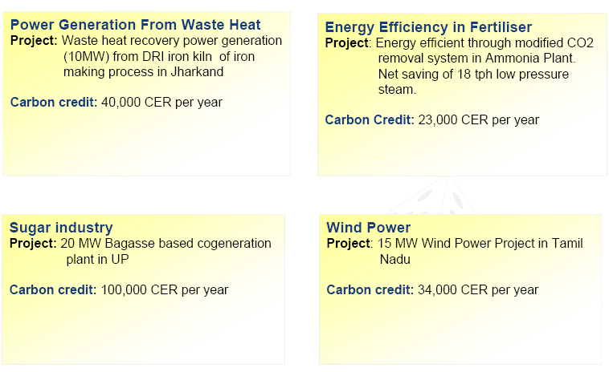
Typical CDM Case Studies
P.K. Modi & Co. 15.07.2012

Slide 26
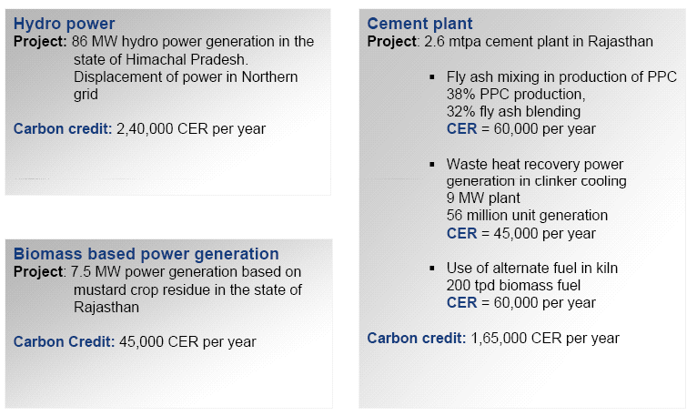
Some more Examples
P.K. Modi & Co. 15.07.2012

Slide 27
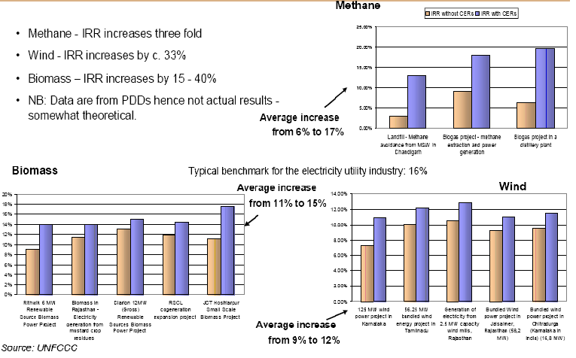
Effect of CDM credits on Investment Returns in India
P.K. Modi & Co. 15.07.2012

Slide 28
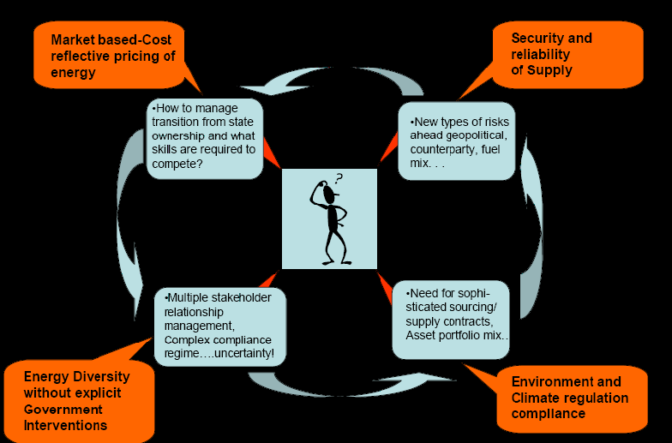
Next Generation Energy Policy Conundrum
P.K. Modi & Co. 15.07.2012

Slide 29
Existing Wind farm
IPP/Part of
business assets
Acquisition
By existing business
For tax saving / Captive
Consumption
Salient and Important Factors inviting Investment.
Depreciation on new acquired assets
Acquisition through SPV for tax free income
PTC
Carbon Credit
Verifiable Data of generation
Value for money known in advance
Improve the balance sheet strength
Assets creation in record time
Good flavor for public Ltd co.
Easy spin off assets in later part
P.K. Modi & Co. 15.07.2012

Slide 30
EPIDECOM – Engineering, Procurement, Installation, Development, Erection, Commissioning, Operation and Maintenance.
P.K. Modi & Co. 15.07.2012

Slide 31
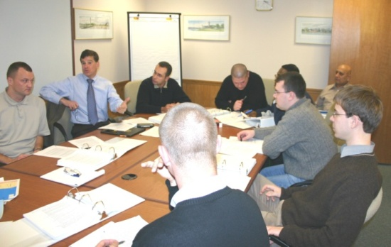
Posers with case study
1. Accounting
Recognition of CER as Revenue or Capital Receipt?
Accounting for CER – Accrual or Actual Receipt Basis.
Cost of Validation of project for CER – Revenue or deferred ?
Trading of CER and its Accounting as commodity – derivatives
Advance receipt of Future CERs and Exchange Fluctuations.
2. Valuation
Valuation of CER at the end of the accounting period.
Whether CER is Intangible Asset or a Commodity ?
3. Taxation
Taxability of CER under Income Tax Act, 1961
Applicability of VAT on sale of CER
P.K. Modi & Co. 15.07.2012

Slide 32
Case Study: Gujarat Fluorochemicals ltd
(Source:http://cdm.unfccc.int/Projects)
Project 0001
Project for GHG emission reduction by thermal oxidation of HFC 23 in Gujarat, India. Project title Project for GHG emission reduction by thermal oxidation of HFC 23 in Gujarat, India.
- project design document (591 KB)
- registration request form (181 KB) Host Parties India approval (904 KB) authorization (904 KB)
Authorized Participants: Gujarat Fluoro chemicals Ltd.
Other Parties Involved Japan approval (2435 KB) authorization (2435 KB)
Authorized Participants: Sumitomo Corporation Netherlands approval (235 KB) authorization (235 KB)
Authorized Participants: Noble Carbon Credits Limited United Kingdom of Great Britain and Northern Ireland approval (113 KB) authorization (113 KB)
Authorized Participants: Ineos Fluor Ltd, EDF Trading Ltd. Italy approval (194 KB) authorization (194 KB)
Authorized Participants: Enel Trade S.p.A. Switzerland , involved indirectly approval (88 KB) authorization (88 KB)
Authorized Participants: Gujarat Fluorochemicals Ltd.
P.K. Modi & Co. 15.07.2012

Slide 33
Case Study: Gujarat Fluorochemicals ltd
(Source:http://cdm.unfccc.int/Projects)
Activity Category ( ies)
The project is principally categorized in: Sectoral Scope 11: "Fugitive emissions from production and consumption of halocarbons and sulphur hexafluoride“
Activity Scale LARGE
Methodologies Used AM0001 ver. 2 - Incineration of HFC 23 Waste Streams
Amount of Reductions 3,000,000 metric tonnes CO2 equivalent per annum
Fee level USD 30000
Validation Report Explanation of taking due account of comments (83 KB)
List of documents (89 KB)
List of interviewed persons (51 KB)
Modalities of communication (4421 KB) Other documents (descriptions provided by the DOE)
Validation report GFL (178 KB)
Annex B: Validation Protocol GFL (1244 KB)
Annex C: Gujarat Pollution Control Board No Objection Certificate (4417 KB)
Validation Opinion GFL (336 KB)
Ozone Rules (19 KB)
Crediting period change request (29 KB)
DOE crediting period confirmation (93 KB)
Public availability information
The Validation report will be made publicly available through the registration process
Compilation of all comments received (83 KB)
P.K. Modi & Co. 15.07.2012

Slide 34
Case Study: Gujarat Fluorochemicals ltd
(Source:http://cdm.unfccc.int/Projects)
Registration Date 08 Mar 05 (view history)
Crediting Period 13 Feb 06 - 12 Feb 16 (Fixed)
Changed from 01 Oct 05 - 30 Nov 15
Requests for Issuance and related documentation
Monitoring report : 01 Oct 2005 - 02 Mar 2006 (482 KB)
Issuance request state: Issued
CERs requested: 83355
[Full view and history]
Monitoring report : 03 Mar 2006 - 30 Apr 2006 (492 KB)
Issuance request state: Issued
CERs requested: 884339
[Full view and history]
Monitoring report : 01 May 2006 - 31 Jul 2006 (153 KB)
Issuance request state: Issued
CERs requested: 1157472
[Full view and history]
P.K. Modi & Co. 15.07.2012

Slide 35
Case Study: Gujarat Fluorochemicals ltd
(Source:http://cdm.unfccc.int/Projects)
Monitoring report: 01 Aug 2006 - 10 Sep 2006 (226 KB)
Issuance request state: Issued
CERs requested: 776460
[Full view and history]
Monitoring report: 11 Sep 2006 - 31 Oct 2006 (530 KB)
Issuance request state: Issued
CERs requested: 822794
[Full view and history]
Monitoring report: 01 Nov 2006 - 03 Dec 2006 (152 KB)
Issuance request state: Issued
CERs requested: 564233
[Full view and history]
Monitoring report: 04 Dec 2006 - 31 Dec 2006 (203 KB)
Issuance request state: Issued
CERs requested: 600920
[Full view and history]
Monitoring report: 01 Jan 2007 - 12 Feb 2007 (204 KB)
Issuance request state: Issued
CERs requested: 841070
[Full view and history]
P.K. Modi & Co. 15.07.2012

Slide 36
Case Study: Gujarat Fluorochemicals ltd
(Source:http://cdm.unfccc.int/Projects)
Monitoring report: 13 Feb 2007 - 31 Mar 2007 (153 KB)
Issuance request state: Issued
CERs requested: 917135
[Full view and history]
Monitoring report: 01 Apr 2007 - 05 May 2007 (154 KB)
Issuance request state: Issued
CERs requested: 487529
[Full view and history]
Monitoring report: 06 May 2007 - 31 Jul 2007 (176 KB)
Issuance request state: Issued
CERs requested: 1852977
[Full view and history]
Monitoring report: 01 Aug 2007 - 31 Oct 2007 (203 KB)
Issuance request state: Issued
CERs requested: 1630165
[Full view and history]
Monitoring report: 01 Nov 2007 - 31 Dec 2007 (241 KB)
Issuance request state: Issued
CERs requested: 1142872
[Full view and history]
Monitoring report: 01 Jan 2008 - 12 Feb 2008 (205 KB)
Issuance request state: Issued
CERs requested: 1186357
[Full view and history]
P.K. Modi & Co. 15.07.2012

Slide 37
Case Study: Gujarat Fluorochemicals ltd
(Source:http://cdm.unfccc.int/Projects)
Monitoring report: 13 Feb 2008 - 31 Mar 2008 (424 KB)
Issuance request state: Issued
CERs requested: 1108191
[Full view and history]
Monitoring report: 01 Apr 2008 - 31 May 2008 (636 KB)
Issuance request state: Issued
CERs requested: 1510855
[Full view and history]
Monitoring report: 01 Jun 2008 - 31 Jul 2008 (647 KB)
Issuance request state: Request for review
CERs requested: 1299638
[Full view and history]
Monitoring report: 01 Aug 2008 - 30 Sep 2008 (626 KB)
Issuance request state: Awaiting issuance request
[Full view and history]
P.K. Modi & Co. 15.07.2012

Slide 38
Case Study: Gujarat Fluorochemicals ltd
(Source:http://www.gfl.co.in)
Carbon Credits Business Driven by its strong beliefs in the principles of Sustainable Development and Corporate Social Responsibility, GFL has developed a UNFCCC-compliant Clean Development Mechanism Project, which earns “carbon credits” by the thermal oxidation of a waste gas, HFC23, in its refrigerant gas manufacturing plant. This was the first CDM Project in the world to seek registration under the Kyoto Protocol, and has been approved by the Governments of India, United Kingdom, Netherlands, Japan and Italy. Since commencement, this project has reduced 13 million tones of greenhouse gas emissions, and the carbon credits so earned have been sold to leading companies across the globe for compliance purposes.
P.K. Modi & Co. 15.07.2012

Slide 39
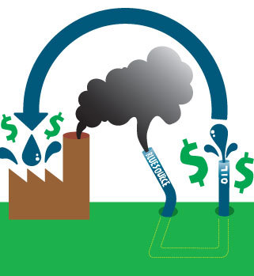
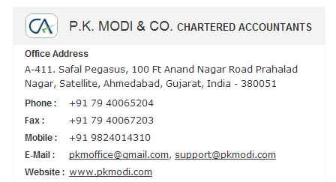
THANK YOU

