Slide 1



Domestic Transfer Pricing
CPE STUDY CENTRE
ICAI GANDHINAGAR
16th November 2013

Slide 2
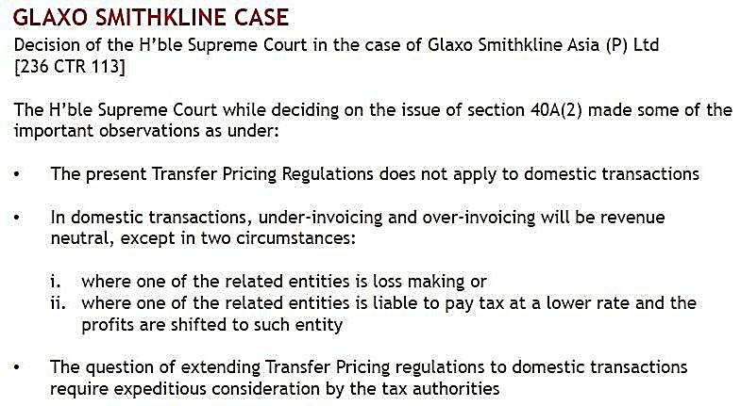

16th November, 2013

Slide 3
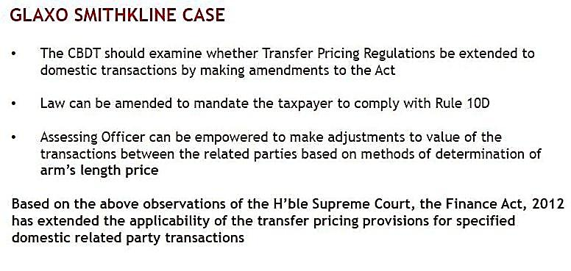
16th November, 2013

Slide 4
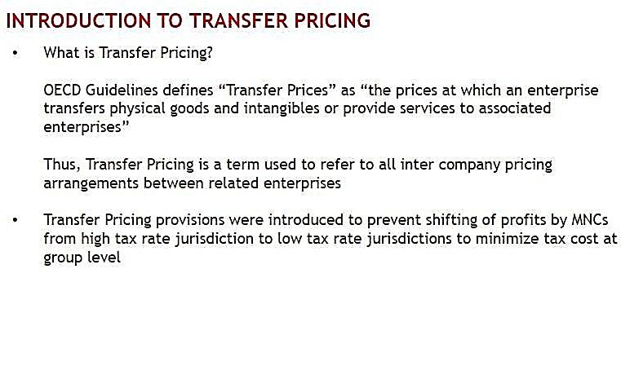

16th November, 2013

Slide 5
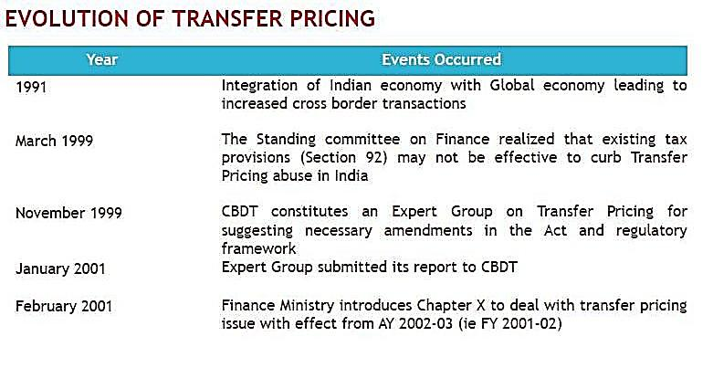
16th November, 2013

Slide 6
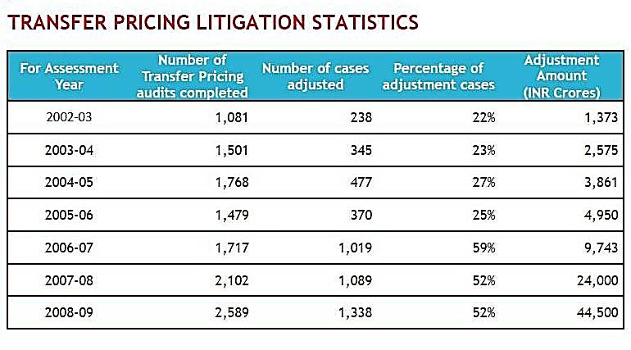
16th November, 2013

Slide 7
Domestic Transfer Pricing
Provisions are in place in following Countries : -
Australia
Brazil
China
France
Russia
South Africa
UK
16th November, 2013

Slide 8
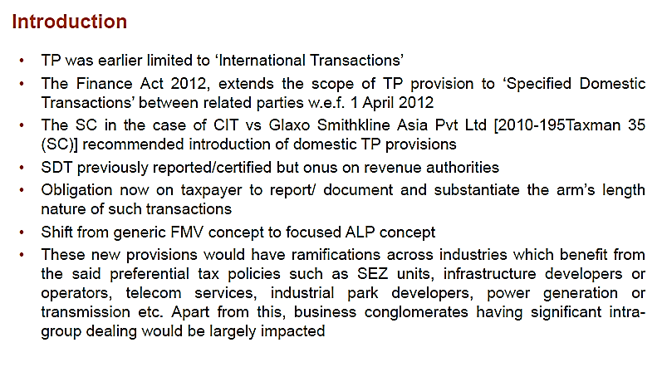
16th November, 2013

Slide 9
Relevant Sections
92 : Arm’s Length Price (ALP)
92C : Method of ALP
92CA : Reference to Transfer Pricing Officer (TPO)
92D : Maintenance of Documents and Information.
92E : CA’s Report
16th November, 2013

Slide 10
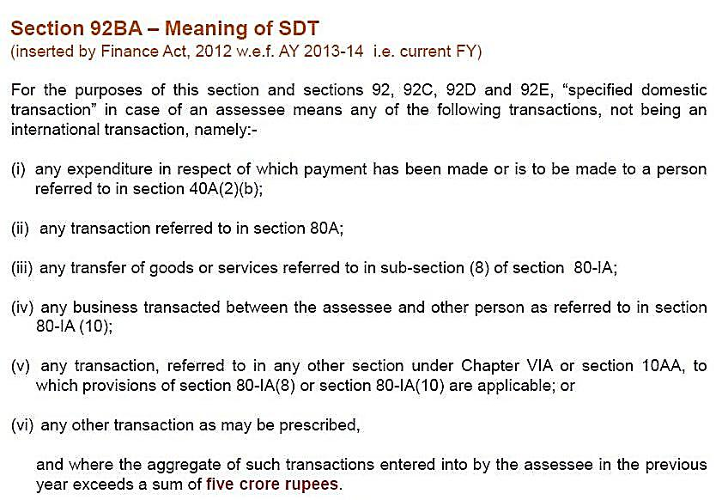
16th November, 2013

Slide 11
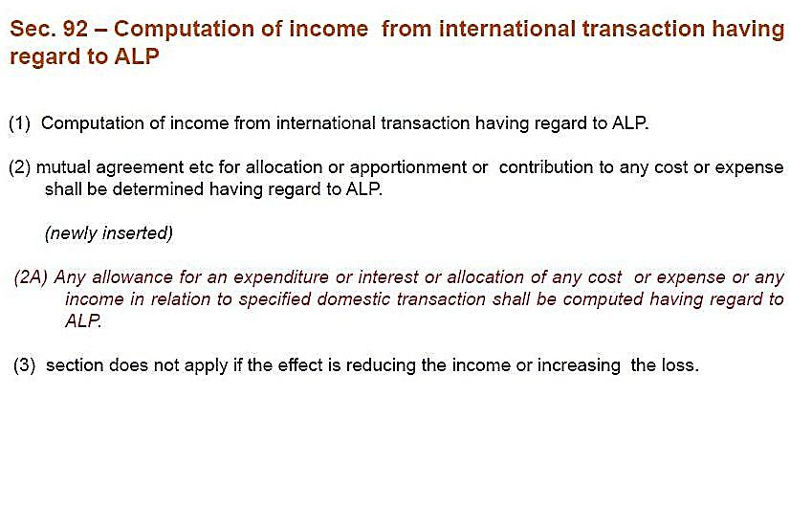
16th November, 2013

Slide 12
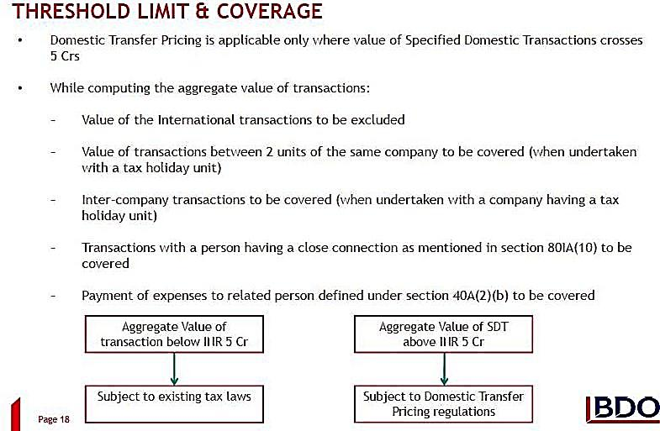


16th November, 2013

Slide 13
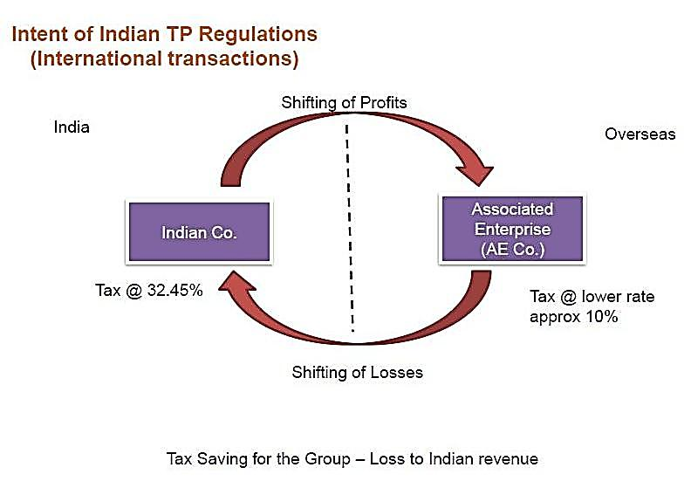
16th November, 2013

Slide 14
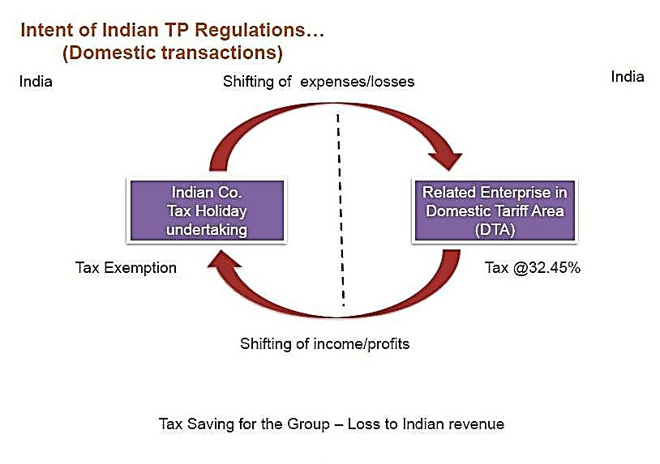
16th November, 2013

Slide 15
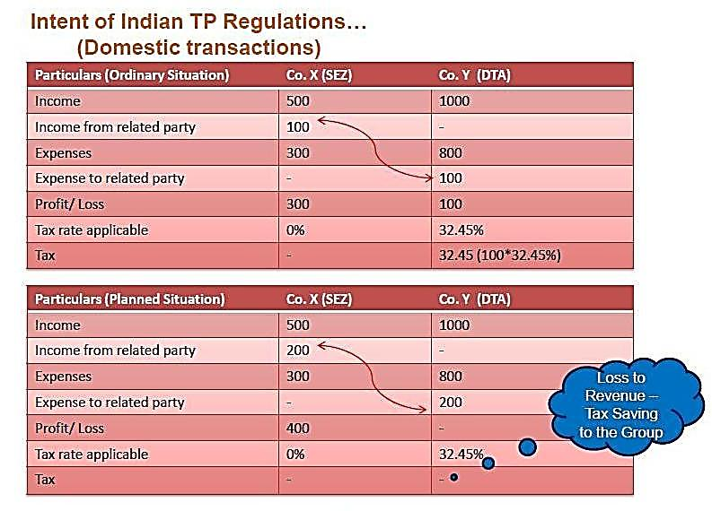
16th November, 2013

Slide 16
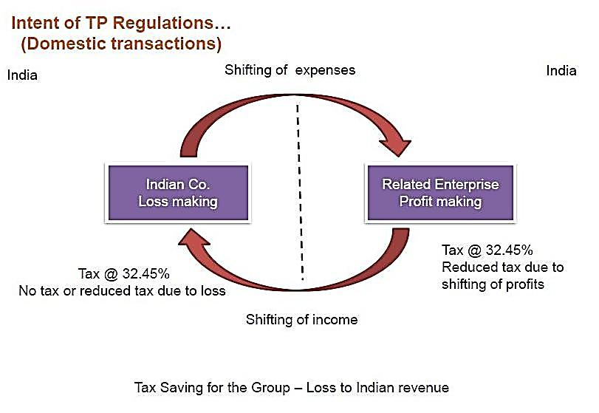
16th November, 2013

Slide 17
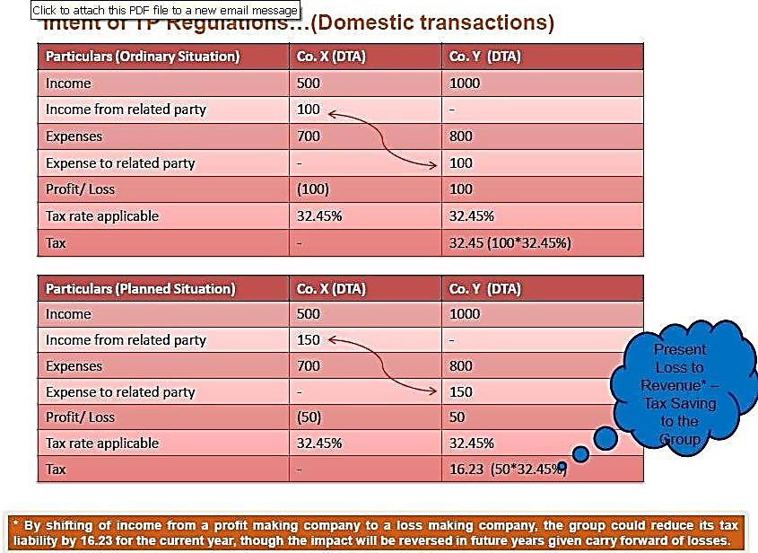
16th November, 2013

Slide 18
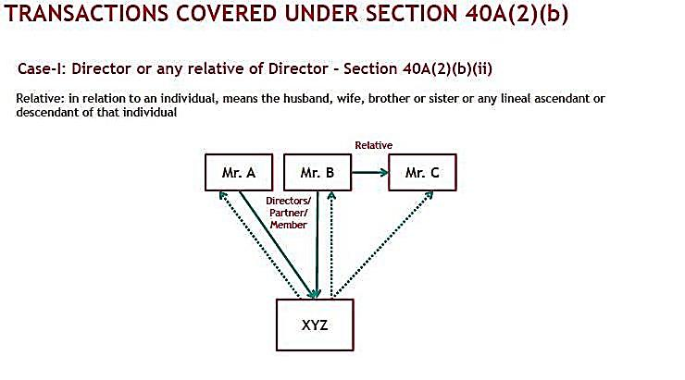
16th November, 2013

Slide 19
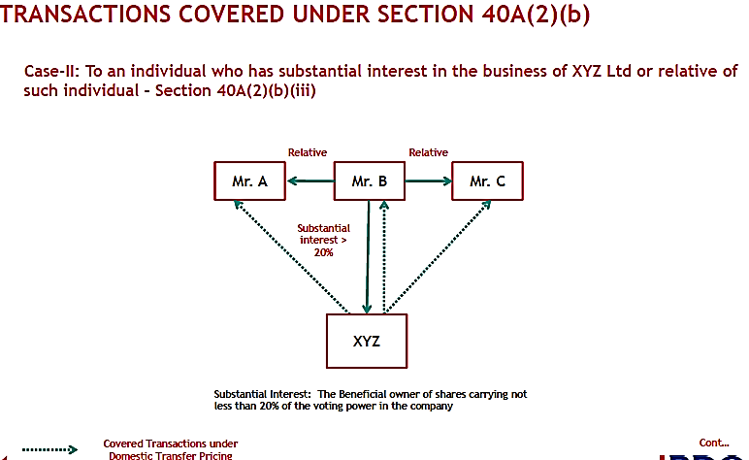
16th November, 2013

Slide 20
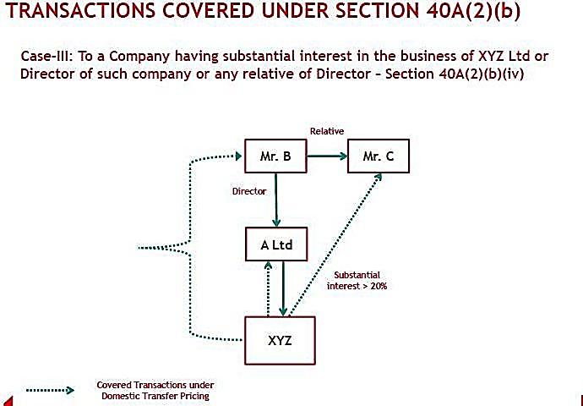
16th November, 2013

Slide 21
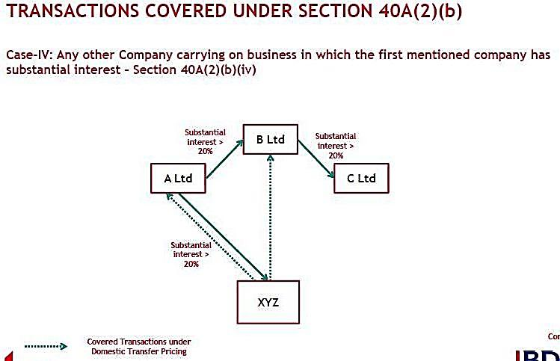
16th November, 2013

Slide 22
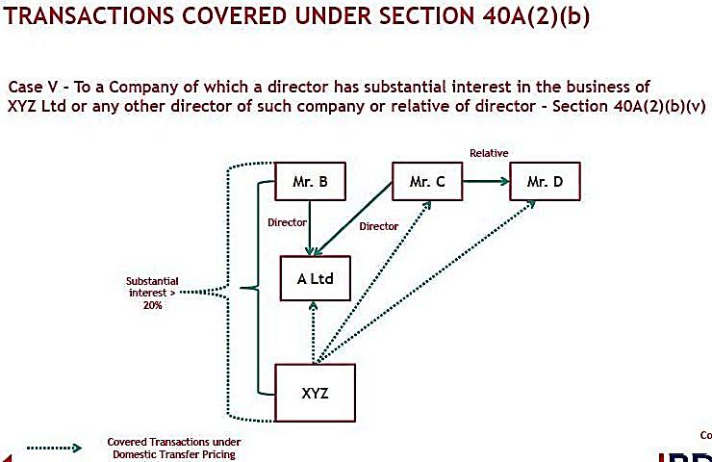
16th November, 2013

Slide 23
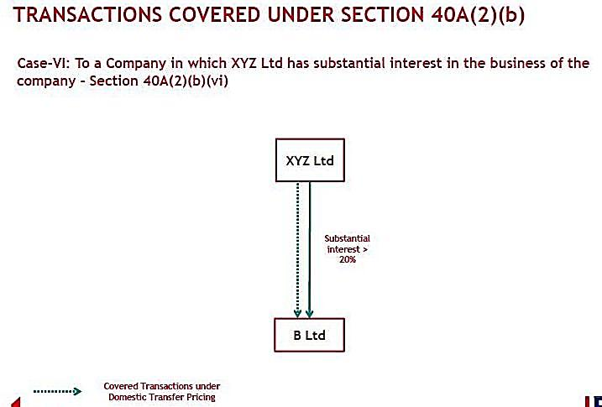
16th November, 2013

Slide 24
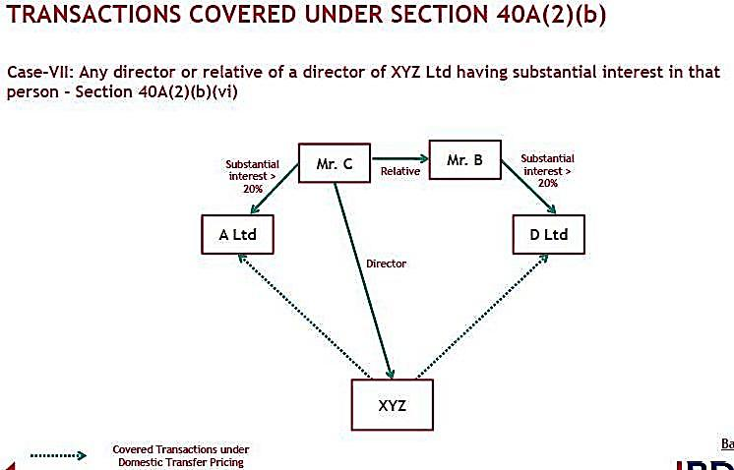
16th November, 2013

Slide 25
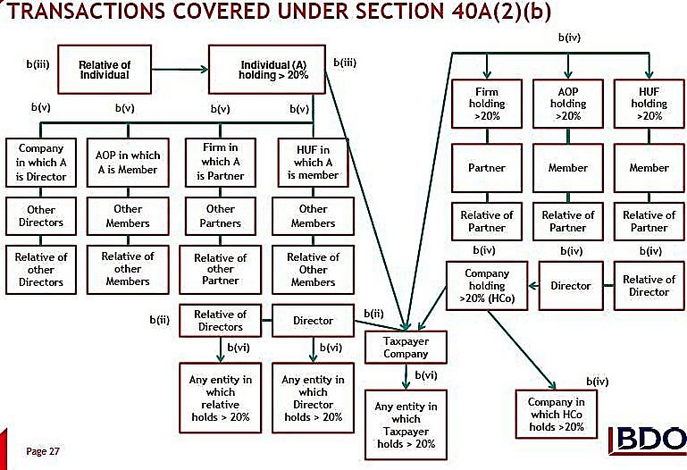
16th November, 2013

Slide 26
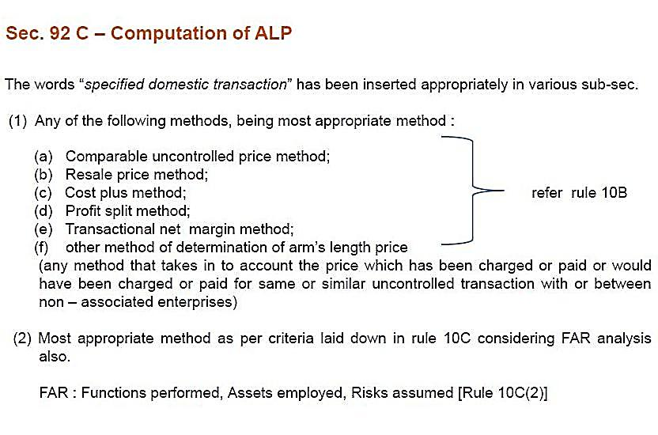
16th November, 2013

Slide 27
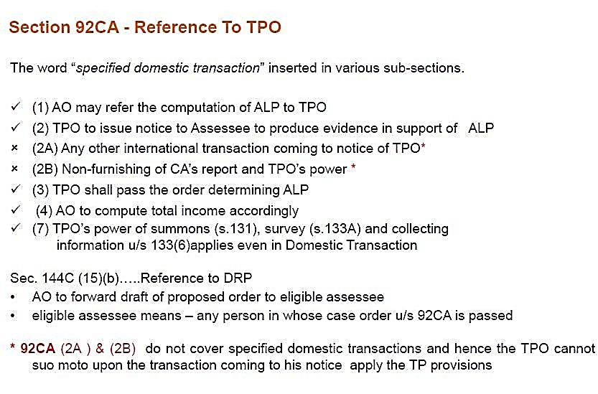
16th November, 2013

Slide 28
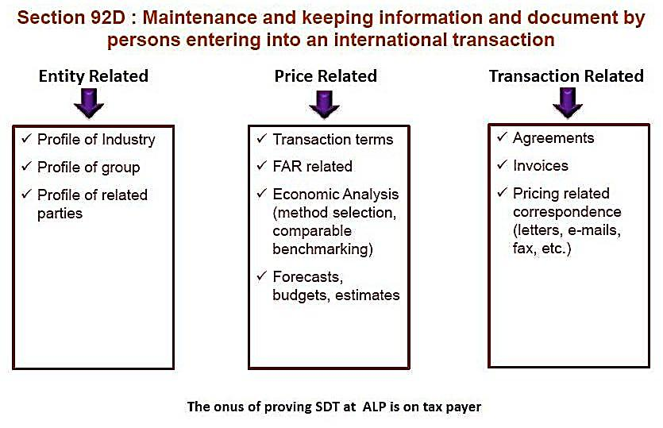
16th November, 2013

Slide 29
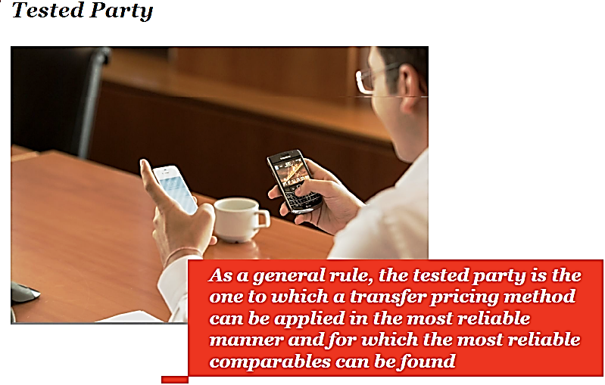
16th November, 2013

Slide 30
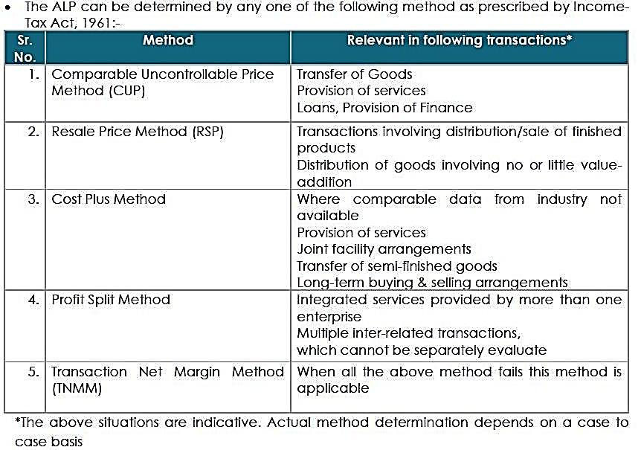
16th November, 2013

Slide 31
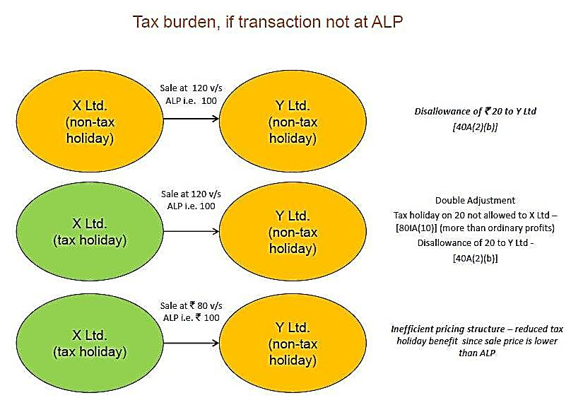
16th November, 2013

Slide 32
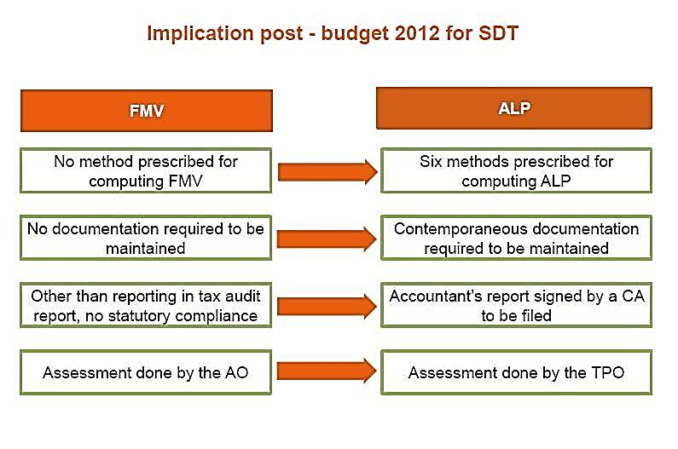
16th November, 2013

Slide 33
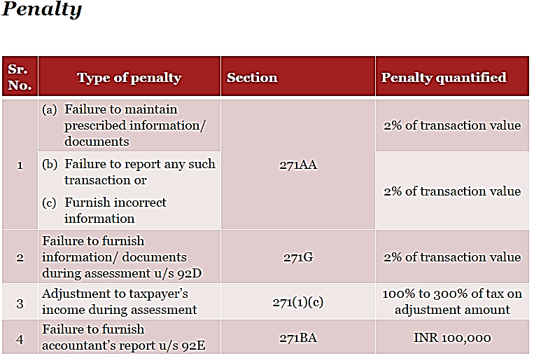
16th November, 2013

Slide 34
DUE DATE
Que:1 What is the due date for filing the Accountant’s report and documentation?
• The Accountant’s report needs to be submitted with the tax authorities by the due date of filing annual return of income. At present, the due date is 30 November.
• Documentation is not required to be submitted along with the Accountant’s report, but is to be in place by the due date. It does need to be submitted during the course of the audit/ assessment.
16th November, 2013

Slide 35
Assessment completion period
Que:2 What is the statute of limitation for completion of assessment?
The time limit for completion of audit is at present will be o 48 months from the end of the relevant tax year.
Assessment/Audit
Que : 3 What is the administrative set up for assessment of Specified
Domestic Transactions?
A separate cell consisting of transfer pricing officers will now perform the assessment of Specified Domestic Transactions instead of assessing officers.
16th November, 2013

Slide 36
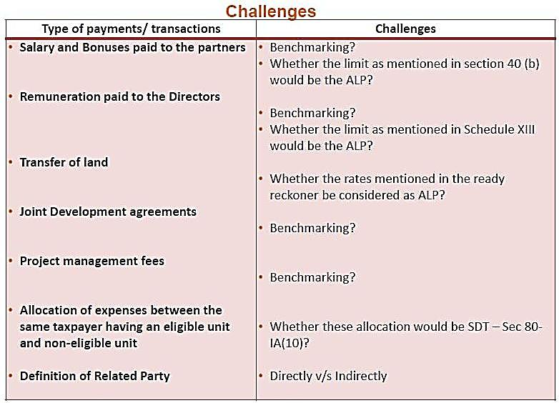
16th November, 2013

Slide 37

Thank you
A-411, Safal Pegasus, 100ft Anand Nagar Road
Prahalad Nagar, Satellite, Ahmedabad-380015
(O) 079 40065204. support@pkmodi.com
www.pkmodi.com

