Slide 1
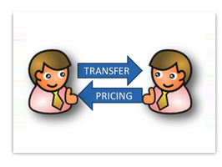
Domestic Transfer Pricing

Slide 2
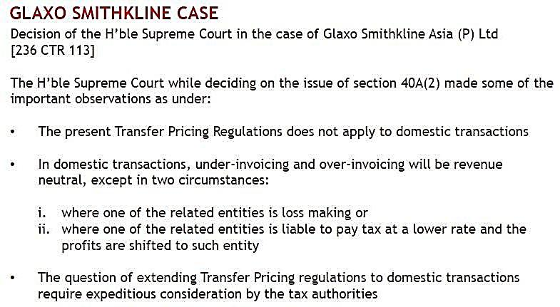
15th October 2013

Slide 3
15th October 2013

Slide 4
15th October 2013

Slide 5
15th October 2013

Slide 6
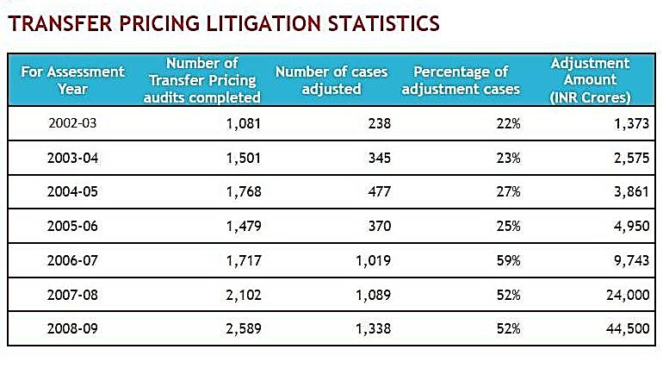
15th October 2013

Slide 7
Domestic Transfer Pricing
Provisions are in place in following Countries : -
Australia
Brazil
China
France
Russia
South Africa
UK
15th October 2013

Slide 8
15th October 2013

Slide 9
Relevant Sections
92 : Arm’s Length Price (ALP)
92C : Method of ALP
92CA : Reference to Transfer Pricing Officer (TPO)
92D : Maintenance of Documents and Information.
92E : CA’s Report
15th October 2013

Slide 10
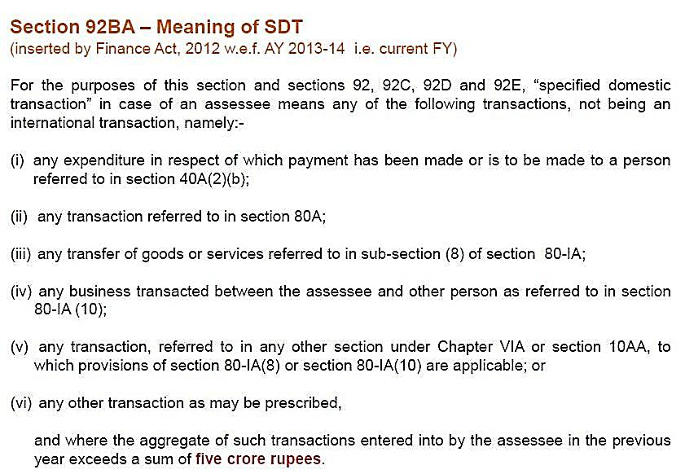
15th October 2013

Slide 11
15th October 2013

Slide 12
15th October 2013

Slide 13
15th October 2013

Slide 14
15th October 2013

Slide 15
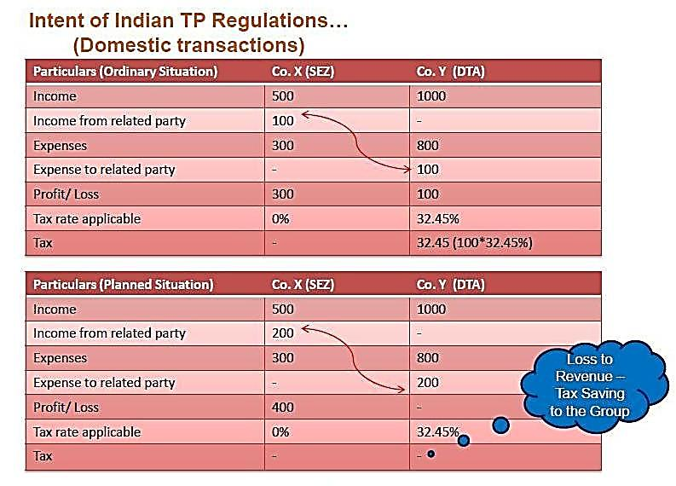
15th October 2013

Slide 16
15th October 2013

Slide 17
15th October 2013

Slide 18
Section 40A(2)(b)
(b) The persons referred to in clause (a) are the following, namely:-
(i) where the assessee is an individual any relative of the assessee;
(ii) where the assessee is a company, any director of the firm, association of persons or company, partner of the Hindu undivided family firm, of member if the association or family, or family, or any relative of such director, partner or member;
(iii) any individual who has a substantial interest in the business or profession of the assessee, or any relative of such individual;
(iv) a company, firm, association of persons or Hindu undivided family having a substantial interest in the business or profession of the assessee or any director, partner or member of such company, firm, association or family, or any relative of such director, partner or member;
(v) a company, firm, association of persons or Hindu undivided family of which a director, partner or member, as the case may be, has a substantial interest in the business or profession of the assessee; or any director, partner or member of such company, firm, association or family or any relative of such director, partner or member;
(vi) any person who carries on a business or profession,-
15th October 2013

Slide 19
Section 40A(2)(b)
(A) where the assessee being an individual, or any relative of such assessee, has a substantial interest in the business or profession of that person; or
(B) where the assessee being a company, firm, association of persons or Hindu undivided family, or any director of such company, partner of such firm or member of the association or family, or any relative of such director, partner or member, has a substantial interest in the business or profession of that person. Explanation.- For the purposes of this sub- section, a person shall be deemed to have a substantial interest in a business or profession, if,-
(a) in a case where the business or profession is carried on by a company, such person is, at any time during the previous year, the beneficial owner of shares (not being shares entitled to a fixed rate of dividend whether with or without a right to participate in profits) carrying not less than twenty per cent of the voting power; and
(b) in any other case, such person is, at any time during the previous year, beneficially entitled to not less than twenty per cent of the profits of such business or profession.
15th October 2013

Slide 20
15th October 2013

Slide 21
15th October 2013

Slide 22
15th October 2013

Slide 23
15th October 2013

Slide 24
15th October 2013

Slide 25
15th October 2013

Slide 26
15th October 2013

Slide 27
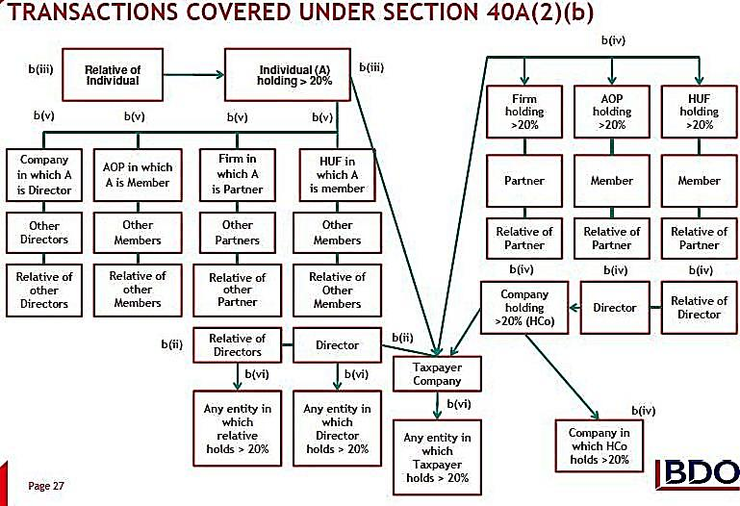
15th October 2013

Slide 28
15th October 2013

Slide 29
15th October 2013

Slide 30
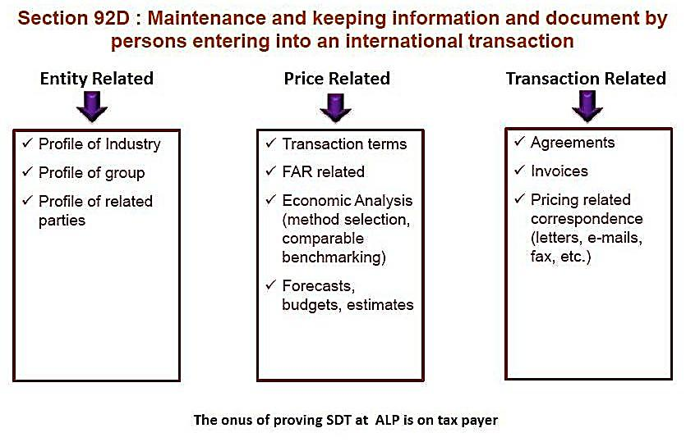
15th October 2013

Slide 31
15th October 2013

Slide 32
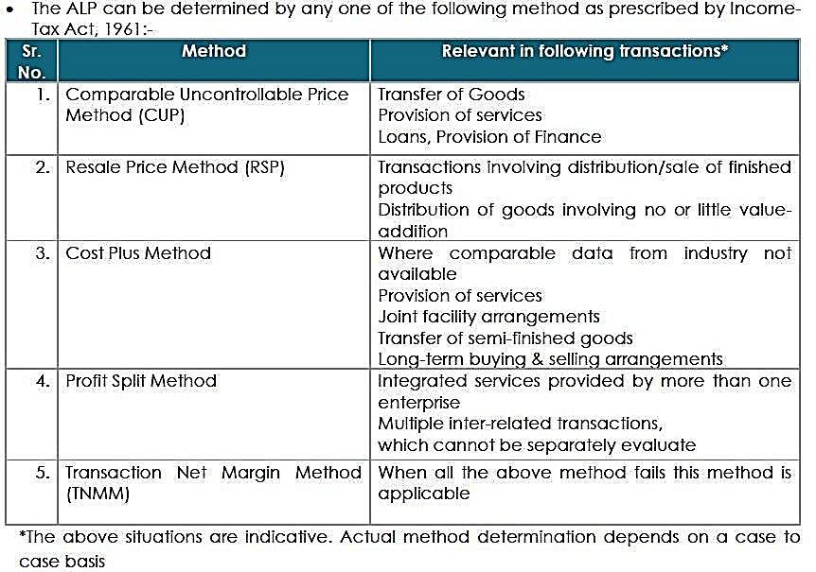
15th October 2013

Slide 33
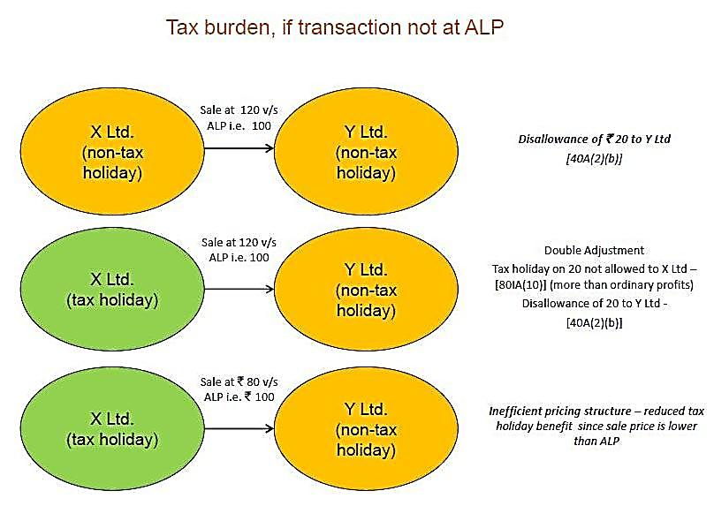
15th October 2013

Slide 34
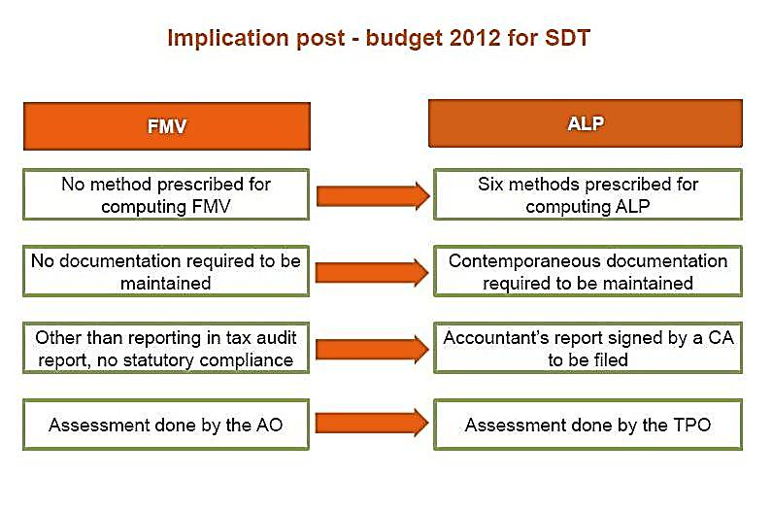
15th October 2013

Slide 35
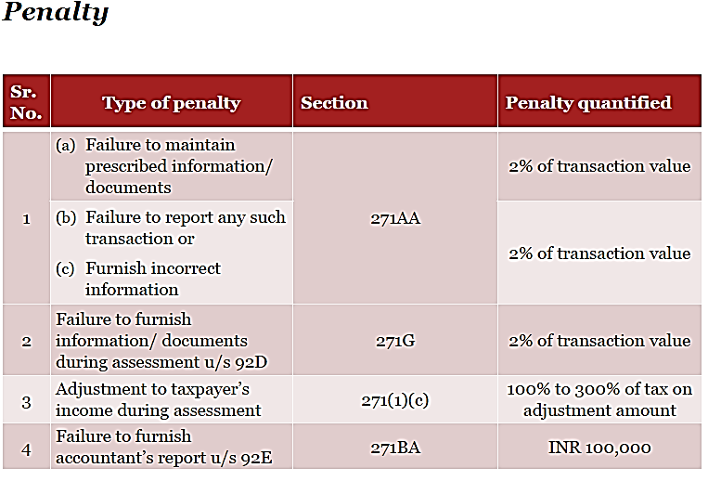
15th October 2013

Slide 36
DUE DATE
Que:1 What is the due date for filing the Accountant’s report and documentation?
• The Accountant’s report needs to be submitted with the tax authorities by the due date of filing annual return of income. At present, the due date is 30 November.
• Documentation is not required to be submitted along with the Accountant’s report, but is to be in place by the due date. It does need to be submitted during the course of the audit/ assessment.
15th October 2013

Slide 37
Assessment completion period
Que:2 What is the statute of limitation for completion of assessment?
The time limit for completion of audit is at present will be o 48 months from the end of the relevant tax year.
Assessment/Audit
Que : 3 What is the administrative set up for assessment of Specified
Domestic Transactions?
A separate cell consisting of transfer pricing officers will now perform the assessment of Specified Domestic Transactions instead of assessing officers.
15th October 2013

Slide 38
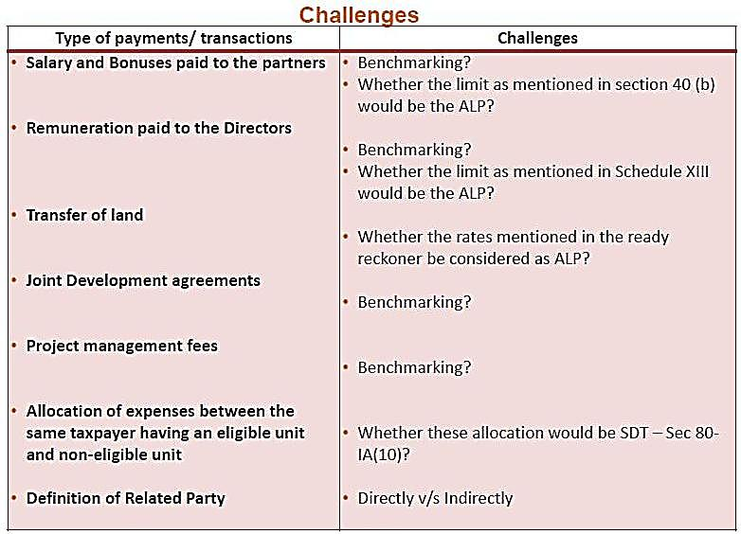
15th October 2013

Slide 39
Thank you
A-411, Safal Pegasus, 100ft Anand Nagar Road
Prahalad Nagar, Satellite, Ahmedabad-380015
www.pkmodi.com
15th October 2013

