Slide 1
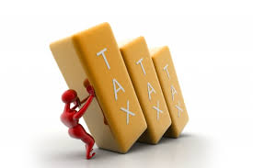

Legal and Tax Aspects of Cross Border Transactions
October 2018
CA PRADIP K MODI

Slide 2
Going Global
Why...
― New markets / customers
― Leverage cost base / economies of scale
― “Learning school” / diversify knowledge base
― Competitive environment
― “First mover” advantage
― Comparative advantage
― Risk shift (volatility – most cyclical production steps to
emerging economies)
CA PRADIP K MODI

Slide 3
Going Global
How...
― Greenfield investment
― Joint ventures / alliances / partnerships
― Cross-border M&A...
CA PRADIP K MODI

Slide 4
What is “ Cross Boarder “ transaction?
Cross-border M&A is a transaction involving parties, securities, substantial assets or operations
located or regulated in different countries
Transactions often involve more than two countries
―US multinational sells UK subsidiary to French buyer
―UK private equity firm sells investment in Chinese manufacturing assets to Indian buyer backed by US lending partners
CA PRADIP K MODI

Slide 5
Pros and Cons of Cross Border M & A
Pros :
Quicker entry to market
Competitive advantages
― Customer base
― Technology
― Brand names
― Distribution network
Eliminate local competition Undervalued due to economic, political and/or foreign exchange conditions?
CA PRADIP K MODI

Slide 6
Pros and Cons of Cross Border M & A
Cons:
Risk of overpaying
Culture clash
Post-merger integration
Host government intervention
― Pricing
― Financing
― Employment guarantees
― Market segmentation
― Favoritism
CA PRADIP K MODI

Slide 7
Challenges in Global M & A transaction
Cross-border transactions are often more difficult to execute than domestic deals
― Language barrier
― Different legal / regulatory environment
― Need for local expertise
― Financing challenges
― Lack of experience / understanding
― Cultural issues
CA PRADIP K MODI

Slide 8
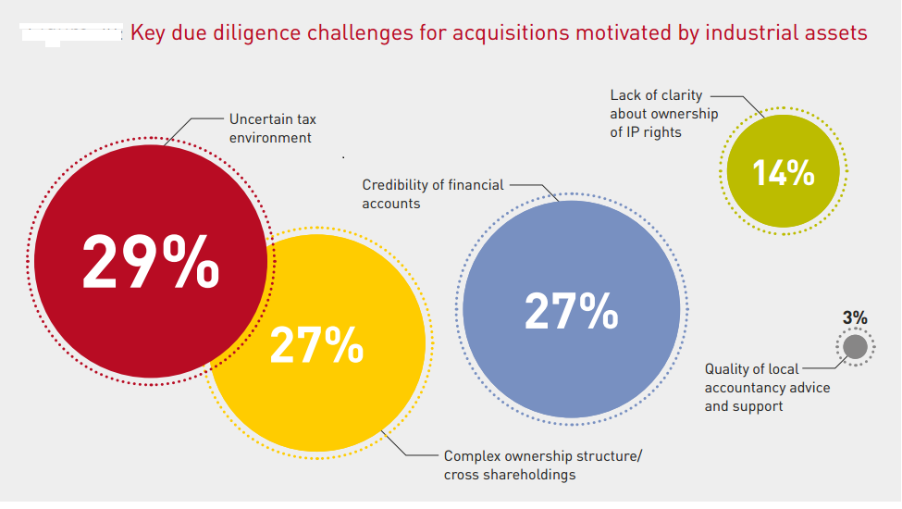
Challenges in Global M & A transaction
CA PRADIP K MODI

Slide 9
Challenges in Global M & A transaction
INBOUND – OUTBOUND
Selection of a Legal Entity
While structuring a new entity in any jurisdiction, one may choose from the following options
which are generally available :
  • Liaison Office
  • Branch
  • Wholly Owned Subsidiary
  • Partnership
  • Trusts
  Sole-proprietorship
  • Other entities
CA PRADIP K MODI

Slide 10
Challenges in Global M & A transaction
Business Structures in Global Environment:
  ‘Substance over Form’ Rule –
  Transfer pricing –
  Tax havens –
  Thin capitalization rules –
  Limitation of Benefits –
  Exchange of information –
  Exchange Control:
CA PRADIP K MODI

Slide 11

THANK YOU.
411-412, SAFAL PEGASUS, 100FT ANAND NAGAR ROAD
PRAHALAD NAGAR, AHMEDABAD-380015.
Email : pkm@pkmodi.com
Ph. 079 40065204

