Slide 1


Future of Indian Currency Looking at Contemporary Scenario
6th Sept 2013
Notes:
This template can be used as a starter file to give updates for project milestones.
Sections
Right-click on a slide to add sections. Sections can help to organize your slides or facilitate collaboration between multiple authors.
Notes
Use the Notes section for delivery notes or to provide additional details for the audience. View these notes in Presentation View during your presentation.
Keep in mind the font size (important for accessibility, visibility, videotaping, and online production)
Coordinated colors
Pay particular attention to the graphs, charts, and text boxes.
Consider that attendees will print in black and white or grayscale. Run a test print to make sure your colors work when printed in pure black and white and grayscale.
Graphics, tables, and graphs
Keep it simple: If possible, use consistent, non-distracting styles and colors.
Label all graphs and tables.

Slide 2
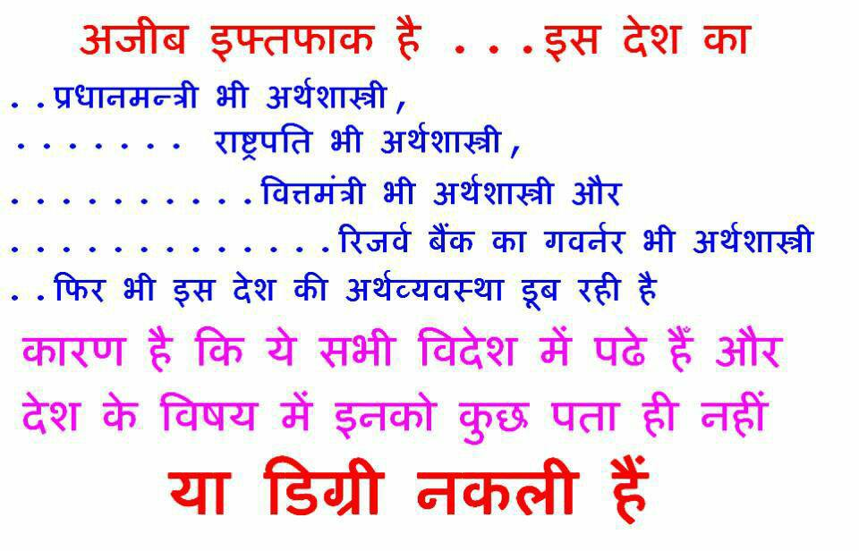

Notes:
What is the project about?
Define the goal of this project
Is it similar to projects in the past or is it a new effort?
Define the scope of this project
Is it an independent project or is it related to other projects?
* Note that this slide is not necessary for weekly status meetings

Slide 3
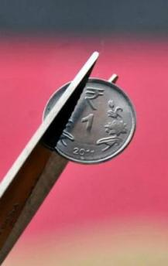

Future of Indian Currency Looking at Contemporary Scenario
Economics is not mathematical strategy but science based on political, psychological and ideological behavior
Understanding on forex reserve
Meaning of Current account deficit
Meaning of Fiscal deficit
Global economy decoupling theory
Role of USA economy in World economy
Notes:
* If any of these issues caused a schedule delay or need to be discussed further, include details in next slide.

Slide 4
Future of Indian Currency Looking at Contemporary Scenario
Fiscal Deficit, Current Account Deficit and Inflation
The purpose of a Budget – and the job of a Finance Minister – is to create the economic space and find the resources to achieve the socio economic objectives. At present, the economic space is constrained because of a high fiscal deficit; reliance on foreign inflows to finance the current account deficit; lower savings and lower investment; a tight monetary policy to contain inflation; and strong external headwinds. During the course of my speech, I shall spell out measures that will address each of these issues.

Slide 5
Future of Indian Currency Looking at Contemporary Scenario
Fiscal Deficit, Current Account Deficit and Inflation
In September, 2012, Government accepted the main recommendations of the Dr. Vijay Kelkar Committee. A new fiscal consolidation path was announced. Red lines were drawn for the fiscal deficit at 5.3 percent of GDP this year and 4.8 percent of GDP in 2013-14. I know there is a lot of scepticism. In a little while, I shall tell you how we have fared.

Slide 6
Future of Indian Currency Looking at Contemporary Scenario
Fiscal Deficit, Current Account Deficit and Inflation
My greater worry is the current account deficit (CAD). The CAD continues to be high mainly because of our excessive dependence on oil imports, the high volume of coal imports, our passion for gold, and the slow down in exports. This year, and perhaps next year too, we have to find over USD 75 billion to finance the CAD. There are only three ways before us: FDI, FII or External Commercial Borrowing (ECB). That is why I have been at pains to state over and over again that India, at the present juncture, does not have the choice between welcoming and spurning foreign investment. If I may be frank, foreign investment is an imperative. What we can do is to encourage foreign investment that is consistent with our economic objectives

Slide 7
Future of Indian Currency Looking at Contemporary Scenario
Budget Estimates :
Budget Estimates
I shall now turn to the Budget Estimates for 2013-14.
The estimate of Plan Expenditure is placed at 5,55,322 Crore.
As a proportion of total expenditure, it will be 33.3 percent.
Non Plan Expenditure is estimated at 11,09,975 Crore.
When we accepted the main recommendations of the Kelkar report, I had drawn some red lines and promised that I would not cross those lines. I am glad to report that I have kept my promise. The fiscal deficit for the current year has been contained at 5.2 percent and the fiscal deficit for the year 2013-14 is estimated at 4.8 percent. The revenue deficit for the current year will be 3.9 percent and the revenue deficit for the year 2013-14 is estimated at 3.3 percent. We must redeem our promise by 2016-17 and bring down the fiscal deficit to 3 percent, the revenue deficit to 1.5 percent and the effective revenue deficit to zero.

Slide 8
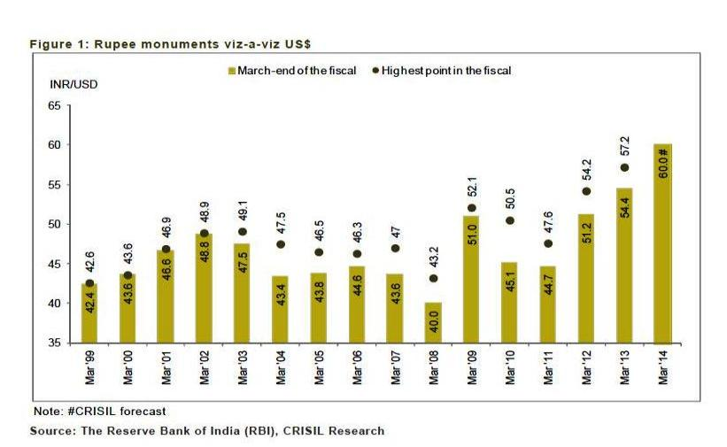
Future of Indian Currency Looking at Contemporary Scenario
Notes:
Duplicate this slide as necessary if there is more than one issue.
This and related slides can be moved to the appendix or hidden if necessary.

Slide 9
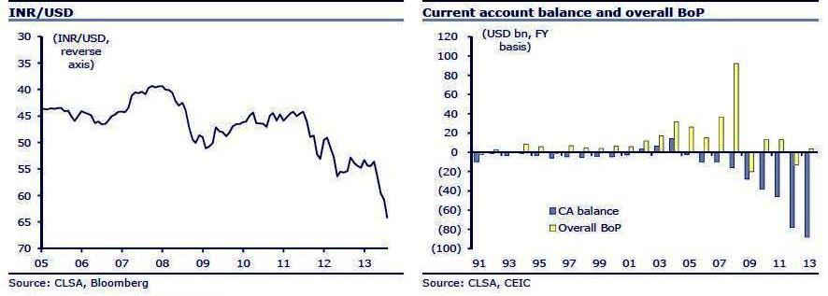
Future of Indian Currency Looking at Contemporary Scenario
Notes:
The following slides show several examples of timelines using SmartArt graphics.
Include a timeline for the project, clearly marking milestones, important dates, and highlight where the project is now.

Slide 10
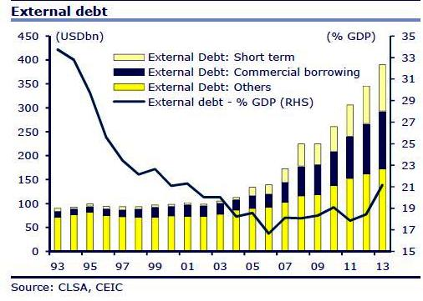
Future of Indian Currency Looking at Contemporary Scenario

Slide 11
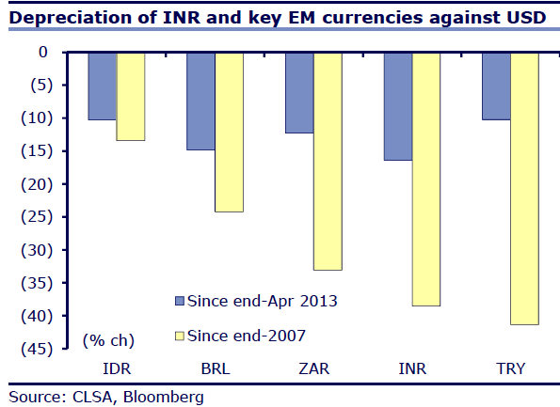
Future of Indian Currency Looking at Contemporary Scenario

Slide 12
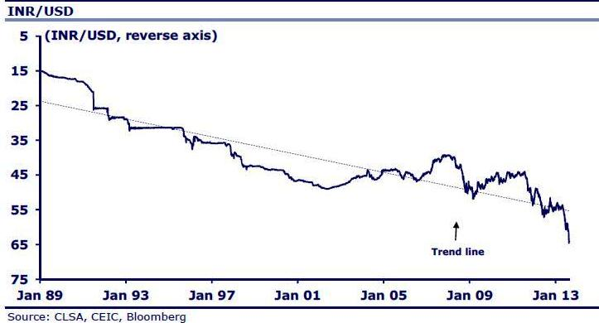
Future of Indian Currency Looking at Contemporary Scenario

Slide 13
Future of Indian Currency Looking at Contemporary Scenario

Slide 14
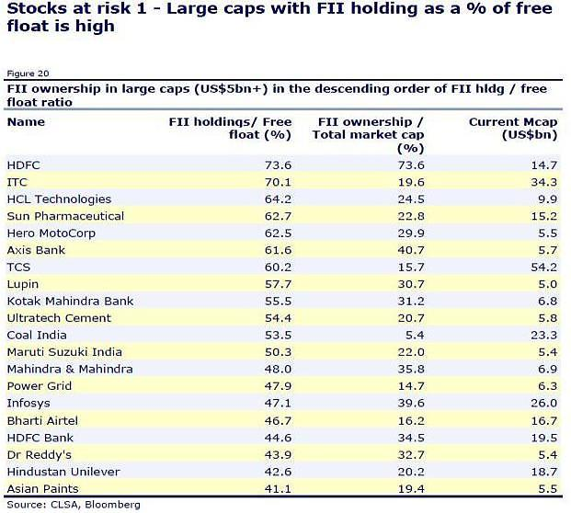
Future of Indian Currency Looking at Contemporary Scenario

Slide 15
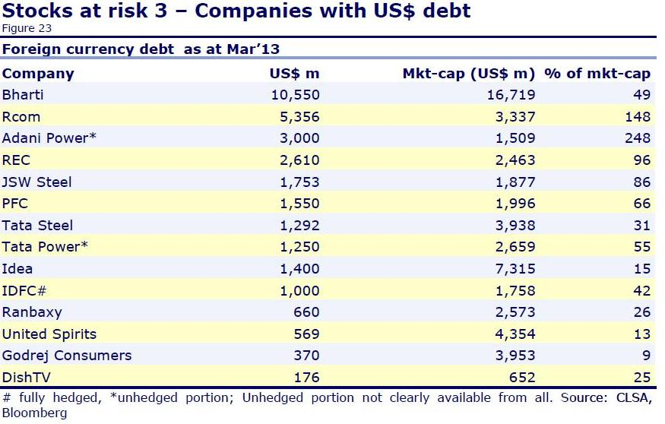
Future of Indian Currency Looking at Contemporary Scenario

Slide 16
Future of Indian Currency Looking at Contemporary Scenario
List by the International Monetary Fund (2012)^{[2]}

Slide 17

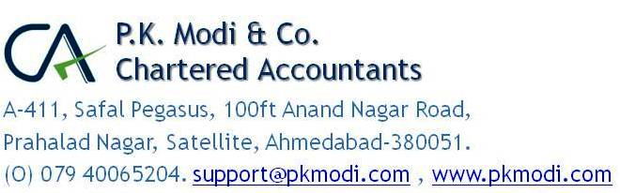
Thank you….
Notes:
Prepare slides for the appendix in the event that more details or supplemental slides are needed. The appendix is also useful if the presentation is distributed later.

